Slide 1
Contraceptive Counseling at Universities Student Outreach Program “Campus Talk”
SUGGESTED DRAFT SLIDE DECK : ALLOWS FOR REGIONAL ADAPTATIONS AND SPEAKER AMENDMENTS. THE MATERIAL PRESENTED DOES NOT NECESSARILY REFLECT THE VIEWPOINTS OF THE MEMBERS OF THE WCD PARTNER COALITION. A QUALIFIED HEALTHCARE PROVIDER SHOULD BE CONSULTED BEFORE USING ANY THERAPEUTIC PRODUCT DISCUSSED. READERS SHOULD VERIFY ALL INFORMATION AND DATA BEFORE TREATING PATIENTS OR EMPLOYING ANY THERAPIES DESCRIBED IN THIS EDUCATIONAL ACTIVITY.

Slide 2
Chapter 1:
The global challenge of unintended teenage pregnancy, STDs and contraception

Slide 3
Do you know…
YOUNG PEOPLE TODAY
  half the world’s population is under 25¹
  more than 1.75 billion people are aged 10-24 (the largest generation)¹
  one third of total disease burden in adults is attributed to problems initiated in adolescence¹
¹IPPF, 2009

Slide 4
Do you know…
YOUNG PEOPLE, SEX & CONTRACEPTION
  only 17% of sexually active young people use contraception¹
  adolescent girls more likely to have unpredictable sex, know less of contraceptive options, and have contraceptive failure²
  teenage pregnancies more related to poor access to contraception than differences in sexual behaviour³
  ¹IPPF, 2009; ²Blanc et al, 2009; ³Guttmacher Institute, 2010

Slide 5
Do you know…
UNPLANNED PREGNANCY
  a third of 200 million pregnancies are unplanned each year¹
  in USA, 52% of these pregnancies are due to non-use of contraception, 43% to inconsistent or incorrect use, and 5% to method failure²
  obstetric complications are leading cause of death in women aged 15-19 in developing countries³
  ¹United Nations Millennium Development Report, 2010; ²Sedgh et al, 2007; ³Mayor, 2004

Slide 6
Do you know…
IMPACT OF UNPLANNED PREGNANCY
  one in 10 births in the world is to a mother who is herself a child¹
  unplanned pregnancies result in emotional distress to these girls and their families²
  teenage pregnancies may lead to health, social, cultural &
  economic problems³
  children born to teenage mothers are likely to have developmental, behavioural & schooling issues⁴
  ¹Save the children, 2004; ²Mavranezouli et al, 2009; ³Amy et al, 2007; ⁴Whitman, T.L., Borkowski, J.G., Schellenbach, C.J., & Nath, P.S. (1997). Predicting and understanding developmental delay of children of adolescent mothers: A multidimensional approach. American Journal of Mental Deficiency, 92(1), 40-56.

Slide 7
Do you know…
YOUNG PEOPLE AND SEXUALLY TRANSMITTED INFECTIONS (STIs)
  rate higher in adolescents & young adults (aged 15-24) than older adults (25 or more)¹
  young people contribute to 50% of all new HIV infections²
  few young people have access to acceptable and affordable
  STI services³
  about 500,000 young people are newly infected with STI each day⁴
  ¹Center for Disease Control and Prevention, 2006; ²WHO, 2006; ³WHO, 2005; ⁴WHO, 2005

Slide 8
“Talking sex and contraception” survey
Report of attitudes of 3,850 young people aged 15-24 years across 18 countries in four continents (Asia-Pacific, Europe, Latin America,
North America)
 | Key global results
1. | One in three (36%) are having unprotected sex
2. | One in three (35%) are not talking contraception with their partner before having sex
3. | One in three (36%) believe the withdrawal method is effective (not true); one in five (19%) are using withdrawal
4. | Average age of first sex 16 years

Slide 9
“Talking sex and contraception” survey
 | Question | Ranked attitudes
1. | Trusted sources of information | Doctor, Mother, Teacher
2. | Removing barriers | Better sex education, someone in confidence, changing cultural attitudes
3. | Barriers to use | Not available at the time, just forgot/too drunk, prefers not to use/dislike method
4. | Reasons for not talking about contraception | Too self-conscious, assume partners has prepared/responsible, not cool

Slide 10
Awareness of unintended pregnancy among young people in 4 world regions
Question:
“I have a close friend or family member who has had an unplanned pregnancy”
Percent
Source: Survey – contraception – whose responsibility is it anyway? 2010

Slide 11
How do we address need for sexuality education?
To give advocacy in partnership with governments, non-governmental organisations (NGOs)
To help individuals and their families become aware of sexuality and sexual behaviour on quality of life.
To provide sound education to address serious consequences of unpreparedness in sexual behaviour.
To prepare young people from beginning of sexual development to be sexually responsible to themselves
and others.

Slide 12
Sexually transmitted diseases (STI)
STIs are caused by more than 30 different bacteria, viruses and parasites and are spread predominantly by sexual contact, including vaginal, anal and oral sex.
The majority of STIs are present without symptoms.
Some STIs can increase the risk of HIV acquisition
three-fold or more.
STIs can have serious consequences beyond the immediate impact of the infection itself, through mother-to-child transmission of infections and chronic diseases.
WHO: Sexually transmitted infections (STIs). Fact sheet N°110, Updated November 2013. http://www.who.int/mediacentre/factsheets/fs110/en/

Slide 13
STI: A global problem
>530 million people have the virus that causes genital herpes (HSV2).
>290 million women have a human papillomavirus (HPV) infection
>1 million people acquire a sexually transmitted infection (STI) every day.
Each year, an estimated 500 million people become ill with one
of 4 STIs:
  Chlamydia
  Gonorrhoea
  Syphilis
  Trichomoniasis.
WHO: Sexually transmitted infections (STIs). Fact sheet N°110, Updated November 2013. http://www.who.int/mediacentre/factsheets/fs110/en/

Slide 14
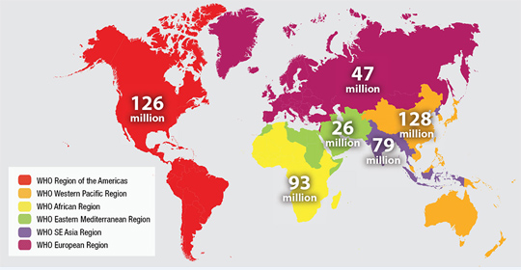
STI: A global problem
Estimated new cases of curable sexually transmitted infections (gonorrhoea, chlamydia, syphilis and trichomoniasis) by WHO region, 2008
WHO: Sexually transmitted infections (STIs). Fact sheet N°110, Updated November 2013. http://www.who.int/mediacentre/factsheets/fs110/en/

Slide 15
Most important STIs in brief
Bacterial causes
Chlamydia
Most common STD
Painful urination
Discharge from urethra, vagina and penis
Can lead to pelvic infection, tubal damage, infertility, chronic pain
Specific treatment (antibiotic)
Gonorrhoea
Also common STD
Painful urination
Discharge from urethra, vagina and penis
Can lead to pelvic infection, tubal damage, infertility, chronic pain
May affect eyes, or joints and even heart
Specific treatment (antibiotic)
Syphilis
Less common STD
Primary infection as solitary painless ulcer in vulva or penis
Can lead to body rash (secondary – weeks later), and brain, liver, heart damage (tertiary – years later)
May infect fetus during pregnancy
Specific treatment (antibiotic)
Notes:
(Read slide)
The following STDs are caused by bacteria:
Chlamydia
If chlamydia is present, pain when passing urine and discharge from the penis or vagina are common.
Syphilis
These bacteria may enter the mouth, penis or vagina during sexual activity, and spread. Initially it stays as a sore,then invades the body-reaching the liver/brain.
Gonorrhea
These bacteria may invade the penis and vagina during intercourse. Pain when passing urine or discharge from the vagina or penis is also common.

Slide 16
Most important STIs in brief
Viral causes
Genital Warts
Human papilloma virus (HPV), very common STD, can grow rapidly and spread, especially during pregnancy
Flat patches to raised irregular bumps on vulva or penis, and cervix and peri-anal skin
Subtypes (16 & 18) associated with cancer change in cervix
Vaccine available
Genital Herpes
Herpes simplex virus (HSV type 2, sometimes type 1)
Primary: very painful multiple vesicles/ulcers on vulva (and penis), painful urination
Secondary: less painful
but recurrent
Specific treatment
(anti-viral drug)
Acquired Immune
Deficiency Syndrome (AIDS) is caused by the Human Immunodeficiency Virus (HIV).
Transmitted through:
Sexual contact with a person infected with HIV
Transfusion of contaminated
blood
Needle pricks
from contaminated needles
Transfer of the virus from mother to child during pregnancy
Notes:
(Read slide)
The following STDs are caused by a virus:
Genital warts
The virus is transmitted through skin to skin contact. A common infection, genital warts appear as pink, soft bumps or rough irregular swellings on the genital skin.
Acquired Immune Deficiency Syndrome (HIV- AIDS)
AIDS can be a fatal infection caused by the Human Immunodeficiency Virus (HIV). The immune system becomes impaired and the body cannot protect itself even from common infections like the flu. People with AIDS can get severely sick from otherwise minor infections.

Slide 17

Signs that indicate the presence of a sexually transmitted disease
Smelly discharge coming from penis or vagina
Wound in the vagina or penis that does not heal
Swelling or bumps in the groin area
Pain in passing urine
Rashes
Fever
See a doctor!
Notes:
(Read slide)
If you have any of these symptoms, you must see a doctor immediately.

Slide 18



What is safe sex?
Abstaining from sex is the safest way – a respected and personal decision between two intimate people
Engaging in sexual intercourse using necessary precaution (condom)
Knowing your partner’s sexual history
Making a decision between you and your partner about appropriate contraception (condom and pill)
Notes:
(Read slide)
Abstinence or “no sex” is still the best and most effective way to prevent STDs and unplanned pregnancy. Condoms are not 100 per cent effective in preventing unplanned pregnancies. Condoms will decrease risk of STDs, not the pill.
Young people need to understand that they are expected to be responsible for their actions. Young girls have the the right to insist that their partners use condoms during sex. Young boys should respect their partner’s decision. Good communication and mutual respect are important in relationships.

Slide 19
Chapter 2:
Description of the female reproductive and sexual function

Slide 20
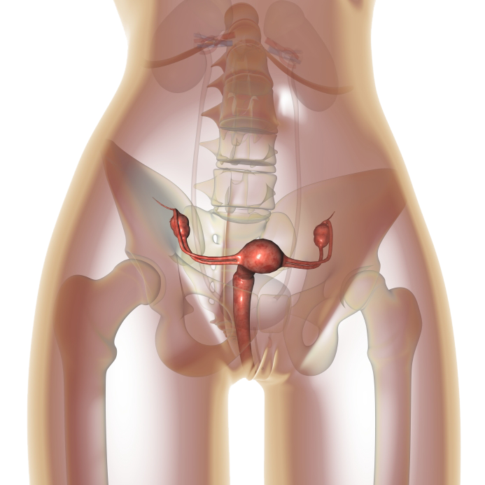
The Female Reproductive System
Notes:
At the end of this section you will be able to:
Outline the physiological events taking place throughout the menstrual cycle.
Understand the mode of action of COCs.

Slide 21
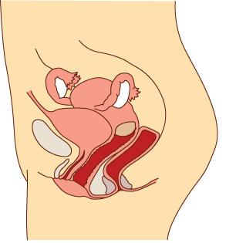
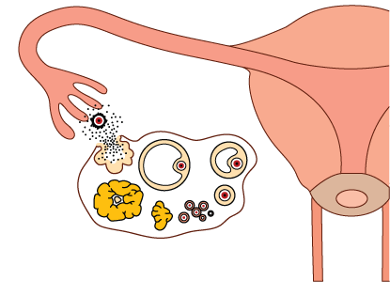
The Female Reproductive System
Notes:
The function of the female reproduction system is to produce an egg,
to nurture it after it has been fertilised,
to protect it as it develops
and finally to deliver it as a mature living baby to the outside world.
The principal organs of the female reproductive tract are:
Click
The ovaries, where eggs are produced.
Click
The fallopian tubes, which lead from the ovaries and deliver the egg to the uterus (or womb).
Click
It is in the uterus that the fertilised egg develops during pregnancy. The lining of the uterus is called the endometrium and, as you will see, it undergoes many changes in order to receive and nurture the fertilised egg.
Click
The vagina leads from the uterus to the exterior of the body.

Slide 22
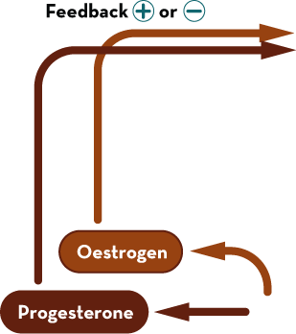
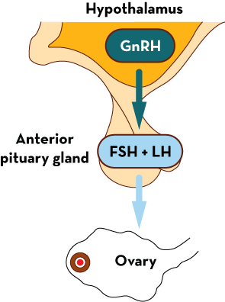
Hormone secretion and feedback
Notes:
A small area of the brain called the hypothalamus secretes gonadotrophin-releasing hormone (GnRH), vital to the menstrual cycle.
GnRH is released in pulses from the hypothalamus, and it travels to another area of the brain, the anterior pituitary gland. Here it triggers the release of two hormones known as gonadotrophins. These are called LH (luteinising hormone) and FSH (follicle-stimulating hormone);
FSH and LH influence the production of the steroid hormones estradiol and progesterone by the ovary (estradiol is the predominant form of oestrogen in nonpregnant women during their reproductive years).
Click
Secretion of GnRH is regulated through feedback (positive or negative) from estradiol and progesterone. Normally this feedback is negative (i.e. steroids inhibit GnRH release), but at one key point in the cycle it switches briefly to positive feedback, so that the steroid stimulates GnRH release). We’ll learn about this shortly.
Thus the production of GnRH, FSH and LH, and estradiol and progesterone is closely interlinked.

Slide 23
Oestrogen vs Progestogen
Oestrogens and progestogens are steroid hormones produced in a woman’s ovaries before menopause. They play an important part in the menstrual cycle and pregnancy.
Oestrogens
synthesized mainly (but not exclusively) by the ovary
control female sexual development
involved in the thickening of the endometrium and other aspects of regulating the menstrual cycle
accelerate metabolism
increase fat stores
help maintain bone strength
may prevent heart disease and protect memory before menopause.
thicken the vaginal wall and increase
vaginal lubrication
Progestogens
secreted by the corpus luteum after ovulation
cause the endometrium (lining of the uterus) to change, allowing a fertilized ovum to become implanted
help to maintain pregnancy, preventing the muscle layers of the uterus from contracting
prevent further ovulation (anti-gonadotropic action)
inhibit the action of androgen (anti-androgenic effect)
bind competitively to the mineralocorticoid receptor to inhibit sodium retention and induce excretion of sodium and water (anti-mineralocorticoid action)

Slide 24
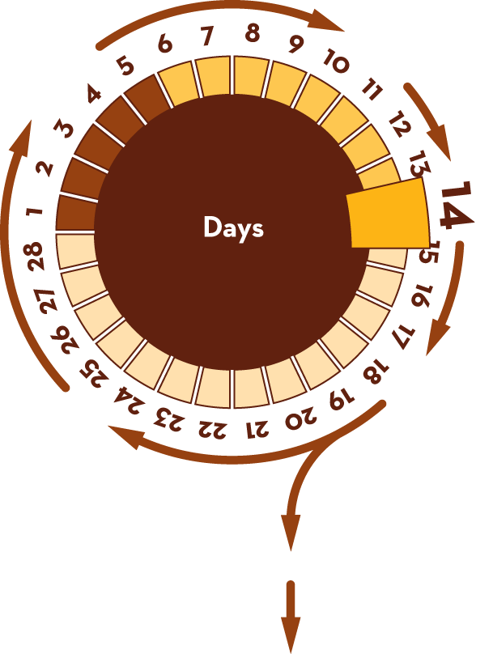
The menstrual cycle
ovulation
pregnancy
Notes:
The menstrual cycle is the name given to the series of changes that the female reproductive system undergoes every month.
By convention, the first day of the menstrual cycle is counted from Day 1 of menstrual bleeding.
The length of the menstrual cycle varies greatly between women; on average however it lasts for 28 days including about 4-5 days bleeding.
Click
Ovulation usually occurs around day 14.
Click
The cycle repeats itself month after month unless pregnancy occurs.
The menstrual cycle is controlled by hormones, chemical messengers produced in at different sites in the body and released into the bloodstream to control and regulate the activity of specific organs.
The hormones that control the menstrual cycle are produced in the brain and in the ovaries. The co-ordination of the events of the cycle depends on a complex interaction between the hypothalamus and the pituitary gland (in the brain) and the ovaries and endometrium. The next slide deals demonstrates this interplay.

Slide 25
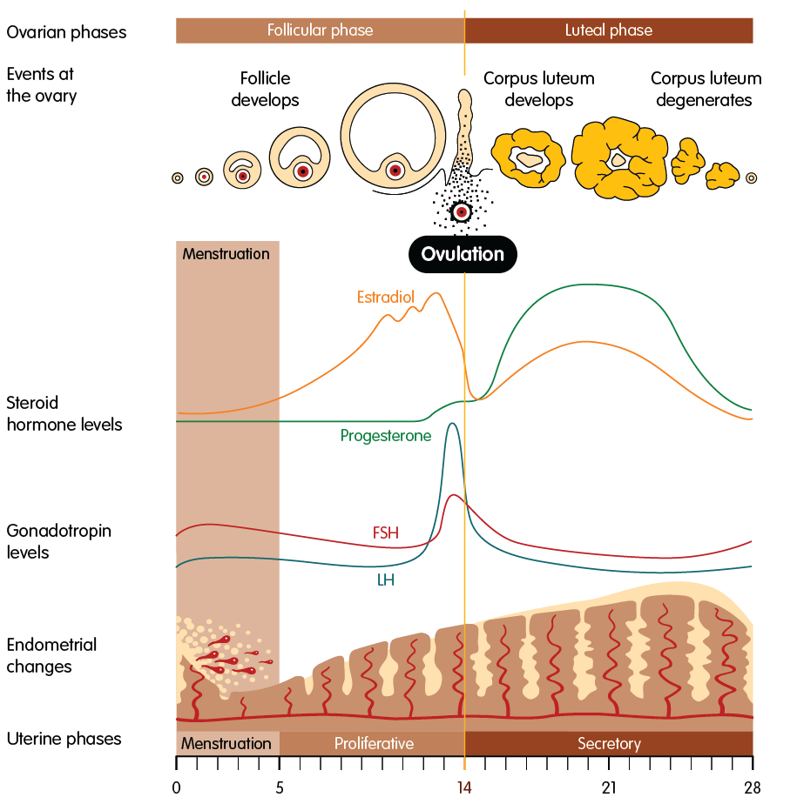
The Uterine & Hormonal Cycle
Notes:
(It would be useful to have a pointer in order to point to relevant part of the figure while talking)
This illustration shows the changing patterns of estradiol and progesterone and the gonadotropins FSH and LH throughout the menstrual cycle. It also shows the effects of these hormones on the endometrium (the lining of the uterus) and on events taking place in the ovaries.
Let’s look now at what causes these changes.
Events in the ovary
The first half of the cycle, before ovulation, is called the follicular phase. The follicle is the fluid-filled sac in the ovary that nurtures the ripening egg and from which the egg is released during ovulation.
The second half, after ovulation, is the luteal phase, after the corpus luteum develops. The corpus luteum is a yellow glandular mass in the ovary formed after the mature ovarian follicle has ruptured and released its egg at ovulation.
During each cycle the ovary produces a single dominant follicle that matures ready for ovulation at mid-cycle. The growth of the follicle depends on the action of FSH from the pituitary.
During the follicular phase the growing follicle produces increasing amounts of estradiol. For the first 12 or so days, estradiol levels rise slowly and its feedback on the hypothalamus is negative, keeping FSH and LH levels stable and low.
Estradiol levels peak towards the end of the follicular phase; at this moment, estradiol feedback switches very briefly from negative to positive. The hypothalamus responds by secreting much more GnRH, resulting in a surge of LH from the pituitary. It is this LH surge that causes ovulation, i.e. rupture of the follicle and release of the egg. The egg is then swept into the fallopian tube, and starts moving down towards the uterus.
During the first few hours after ovulation, the cells of the ruptured follicle change and enlarge to form a new mass of cells, the corpus luteum (yellow body). The corpus luteum secretes estradiol and large amounts of progesterone in order to prepare the endometrium for pregnancy.
What happens next depends on whether or not the ovum is fertilised and implants in the lining of the uterus.
No fertilisation:
If there is no fertilisation, the corpus luteum degenerates, and is absorbed by the body. Steroid levels fall sharply and the endometrium breaks down.
Fertilisation and implantation:
If implantation occurs, the developing embryo prevents the disintegration of the corpus luteum, which continues to produce the estradiol and progesterone essential to maintain the endometrium until this function is taken over by the placenta.
Events in the uterus
At the beginning of the menstrual cycle the endometrium has no functional layer, as this layer was shed during menstruation. As we enter the follicular phase, increasing levels of estradiol produced by the maturing follicle induce proliferation of the endometrium, forming a new functional layer. In the luteal phase the progesterone secreted by the corpus luteum suppresses further growth and stabilises the endometrium; the functional layer becomes secretory, maturating in preparation for implantation.
In the late luteal phase the fall in steroid hormone levels causes the collapse of the blood vessels supplying the endometrium. Blood leaks and the whole functional endometrium is shed, resulting in menstruation.

Slide 26
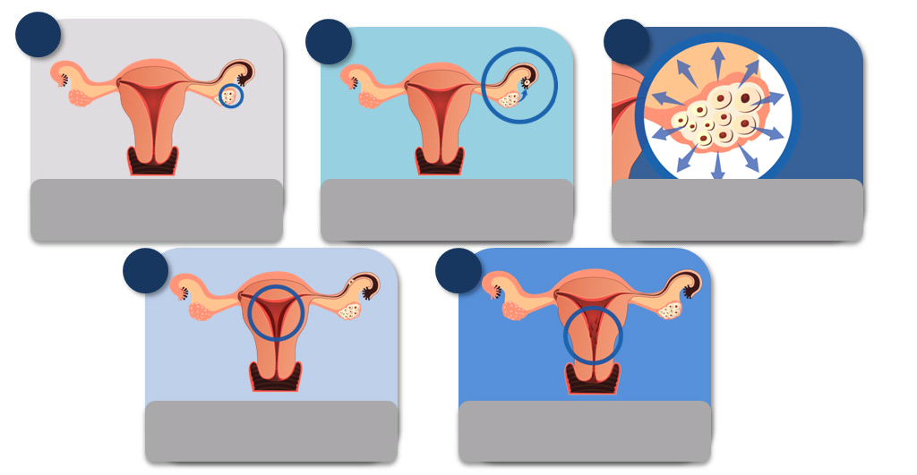
What really happens at “that time of the month”
1
2
3
Production of hormones from ovary (estradiol, then progesterone)
Follicle growth
Release of egg from ovary
4
5
Thickening of lining of uterus
Shedding at end of cycle, resulting in bleeding
“That time of the month” refers to the time when a girl is having her monthly period. Let’s understand what goes on through this cycle.
Notes:
(Read slide)
Let us briefly review the menstrual cycle. The normal menstrual cycle lasts 21 to 35 days. Menstrual loss usually continues for 3-5 days. Menstruation is due to complex interaction of chemicals called hormones in the body. Under control from an area in the base of the brain called hypothalamus, a small structure connected to it called the pituitary gland produces two hormones:
Follicle stimulating hormone (FSH)
Stimulates the development of round bodies or follicles in the ovaries. The follicle contains the egg.
Luteinizing hormone (LH)
Stimulates the release of the egg from the follicle during ovulation, usually one egg in each cycle.
Under control of FSH and LH, the ovaries mainly produce the hormones estradiol and progesterone which will reach a peak during the cycle, and then fall.
Estrogen
Stimulates the lining of the uterus to grow, making it thick.
Progesterone
Changes the thick lining of the uterus preparing for implantation of the embryo if present; otherwise, a fall in levels will result in shedding of the lining - menstruation.
Progesterone also causes mucus or secretions from the cervix to thicken.
(Point to the visual)
In this illustration , you will see the release of an egg (point to the egg) and the shedding of the lining of the uterus. In some cases, menstruation is accompanied by pain and discomfort (point to the sad face) . Dysmenorrhea or menstrual cramps usually begins on the first day of menstruation.
The menstrual cycle has 3 phases:
1.The follicular phase is the phase when follicles in the ovaries develop. The lining of the uterus also thickens during this period. One follicle grows large and releases the egg at mid-cycle.
2. The ovulatory phase is when the egg is released from the ovary during ovulation. This is marked by a surge of luteinizing hormone.The egg is picked up by the fallopian tube to travel to the uterus.The egg is fertilized in the fallopian tube.
Vaginal secretions vary during the menstrual cycle. At ovulation, the mucus from the cervix becomes thinner, stretchable and slippery. This allows sperm to travel easily through the cervix. During this period, a young girl is fertile. Engaging in sexual intercourse at this time may lead to pregnancies. The exact timing of ovulation is uncertain. Secretion from the vagina is not always reliable. Women with regular menstrual cycles are assumed to ovulate approximately 14 days before the start of menstruation. Around this time, engaging in sexual intercourse may result in a woman getting pregnant.
3. The luteal phase lasts about 14 days and ends with menstruation.The follicle which release the egg becomes the yellow body called corpus luteum. The corpus luteum produces progesterone.
Pregnancy may occur when sexual intercourse happens. Young girls are capable of getting pregnant once they have started menstruating.

Slide 27
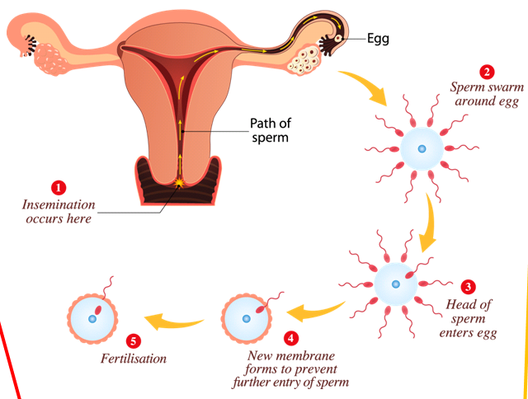
Pregnancy
Pregnancy may occur after sexual intercourse between a girl who has already started menstruating and a boy who has reached maturity
During sexual intercourse, the penis delivers semen into the vagina through ejaculation
Notes:
(Read slide)
If sexual intercourse takes place when the woman is ovulating, the sperm will meet the egg in the fallopian tube. Fusion of egg and sperm is called fertilization.
After fertilization, the fusion of sperm and egg develops into an embryo, a growing body of cells which implants in the uterus and continues to grow into a fetus.
The woman’s body undergoes changes during pregnancy. During pregnancy, a woman may also experience changes in moods and emotions.

Slide 28
Chapter 3:
The description of available
Contraceptive Methods

Slide 29
Types of contraception
Natural: coitus interruptus, calendar method, temperature... –
HIGH FAILURE RATES!
Barrier: male and female condom – The only ones with double protection (pregnancy and STD), however their failure rate is almost as high as with
natural methods
Hormonal contraception - Short term reversible: Combined pills, progestogen-only pills, monthly or quarterly injections, patch, vaginal ring
Hormonal contraception - Long acting reversible: IUD, IUS, implants
Irreversible: Sterilization, vasectomy and tubal implant
Notes:
The last 3 have high efficacy rates!!!!

Slide 30
Natural methods

Slide 31

Calendar method
EVERY TIME
  Establishing which days are fertile by observing menstrual cycles
  Abstaining from sexual intercourse during the
  fertile period
  HIGH failure rates – you can calculate your fertile period incorrectly or ovulation may not occur on the expected date
  Fails in 5-25% of cases

Slide 32
Observing cervical mucus method
EVERY TIME
  Cervical mucus is an odorless secretion produced in
  the neck of the womb. This secretion comes out of
  the vagina at a specific phase of the menstrual cycle
  and can be more fluid and transparent at times
  (when a woman is fertile) and thicker and whiter at others
  (during the infertile period)
  By learning to identify the characteristics of this mucus, a woman can determine the period during which she can or cannot have sexual intercourse if she wants to avoid pregnancy.
  Failure rate: up to 25%

Slide 33
Basal-temperature method
EVERY TIME
  The body temperature of a woman rises during
  ovulation (0.2 to 0.5 degrees)
  An increase in temperature means that the woman
  is ovulating
  Therefore, with this method, by measuring basal temperature every day, it is possible to determine the infertile phase following ovulation
  Failure rate: 25%

Slide 34
Breastfeeding and amenorrhea method
EVERY TIME
  Women who only breastfeed their child (only
  breastfeed their baby when he or she requires it),
  are protected against pregnancy and do not need
  additional contraception to avoid pregnancy, so
  long as their periods have not yet restarted
  Eventually women may ovulate even if their periods have not returned, thereby affecting the efficacy of this method
  Failure rate: 2-4%

Slide 35
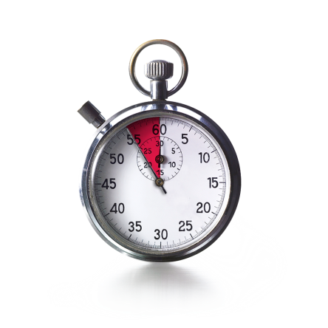
Coitus interruptus method
EVERY TIME
  Withdrawing the penis from the vagina before ejaculation
  As ejaculation occurs outside of the female genitalia,
  conception should not occur
  It can fail due to the involuntary release of some sperm
  before ejaculation
  Failure rate: 4-27%

Slide 36
Barrier methods

Slide 37
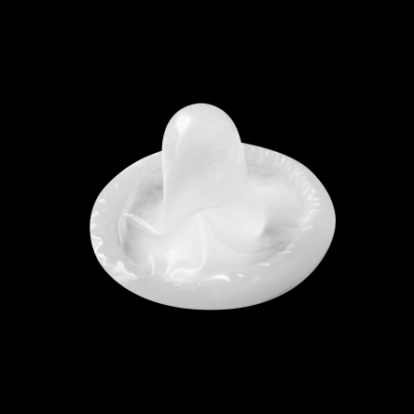
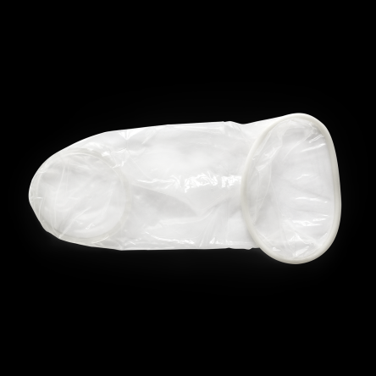
Male and female condom method
EVERY TIME
  Both form a mechanical barrier that prevents
  the passage of sperm
  They are the only methods that protect from
  STIs (sexually transmitted infections)
  Both need to be in position before the start of sexual
  intercourse and kept in place until the end
  Disposable
  Failure rate: 2-21%

Slide 38
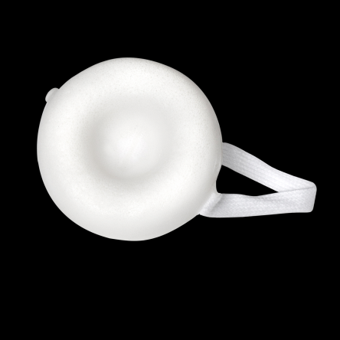
Sponge method
30 HOURS MAX
  The sponge forms a mechanical and chemical
  barrier (spermicide) that prevents the passage
  of sperm. The spermicide has to be activated by
  irrigating the sponge
  It can be used on demand
  It isn’t affected by other medications
  Does not protect against HIV infection (AIDS) and other sexually transmitted infections (STIs)
  Failure rate: 20-24%

Slide 39

Diaphragma method
24 HOURS MAX
  Forms a mechanical and chemical barrier
  (spermicide) that prevents the passage of sperm
  Does not protect against HIV infection (AIDS)
  and other sexually transmitted infections (STIs)
  Needs to be initially fitted by a healthcare provider
  Has to be positioned before the start of sexual intercourse and kept in place until the end
  Failure rate: 6-12%

Slide 40
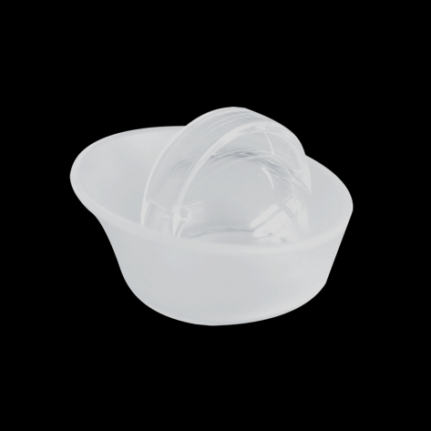
Cervical cap method
48 HOURS MAX
  A cervical cap blocks the entrance to the
  cervix to stop sperm from entering the womb
  It can be used on demand
  They are easily carried with you
  Hormone free
  Requires initial fitting by healthcare provider
  Does not protect against HIV infection (AIDS) and other sexually transmitted infections (STIs)
  Failure rate: 9-16%

Slide 41
Chemical methods

Slide 42
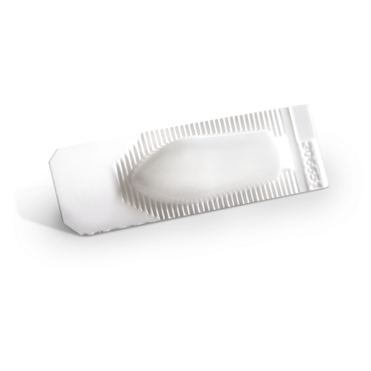
Spermicide method
EVERY TIME
  Spermicides affect the way a sperm travels in
  the womb making it hard for them to move freely
  and fertilize an egg
  It’s easy to use
  It is hormone free
  Should not be used as a contraceptive on its own as it is not effective
  Does not protect against HIV infection (AIDS) and other sexually transmitted infections (STIs)
  Failure rate: 18-28%

Slide 43
Hormonal Contraception

Slide 44
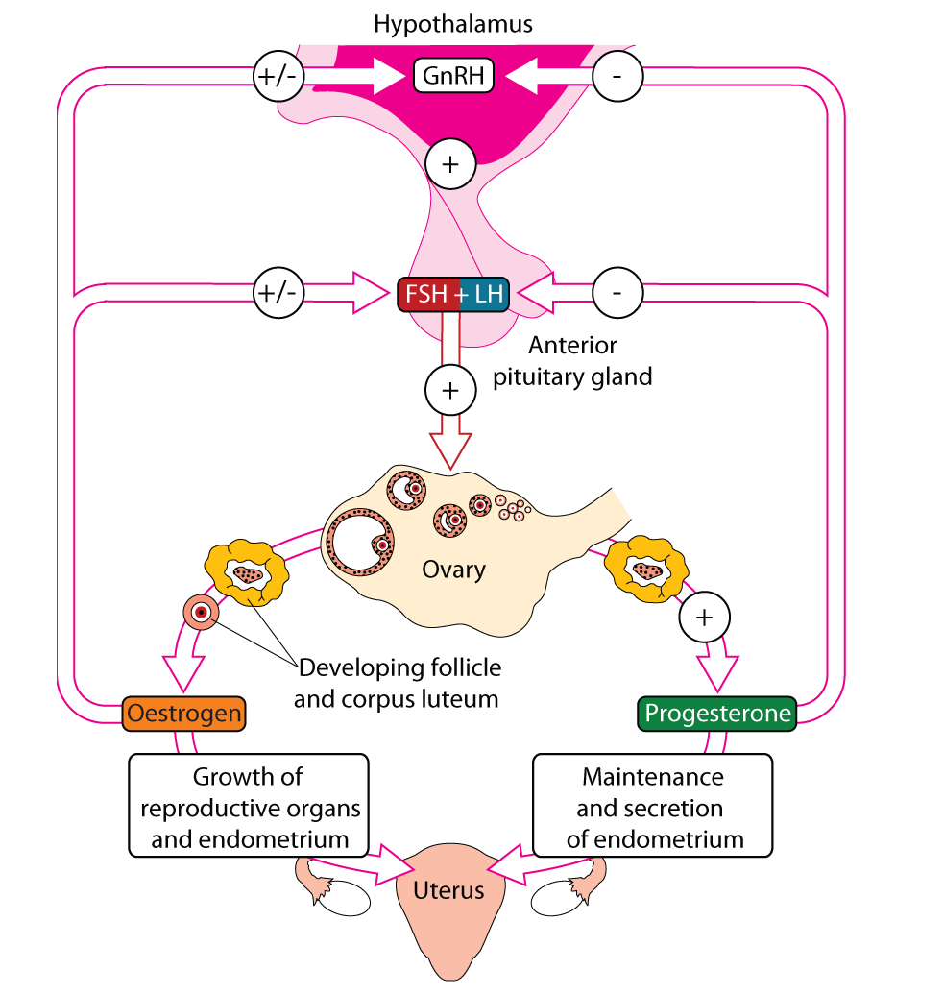
Hormonal contraception: Principle of combined methods (estrogen + progestogen)
CHCs maintain negative feedback through the cycle
Mimics hormonal state of early pregnancy: prevents further ovulation
Continuous progestogen prevents mid-cycle LH surge
Notes:
The hormonal system controlling fertility.
[click]
The continued presence of EE and progestogen inhibit production of GnRH by the hypothalamus and secretion of FSH and LH by the pituitary gland.
[click]
This is the hormonal balance that occurs in early pregnancy to suspend regular ovulation.
[click]
Progesterone is released in larger amounts by the corpus luteum as it decays, signalling to the pituitary that it should not produce the normal surge in luteinising hormone that is needed to trigger ovulation.

Slide 45
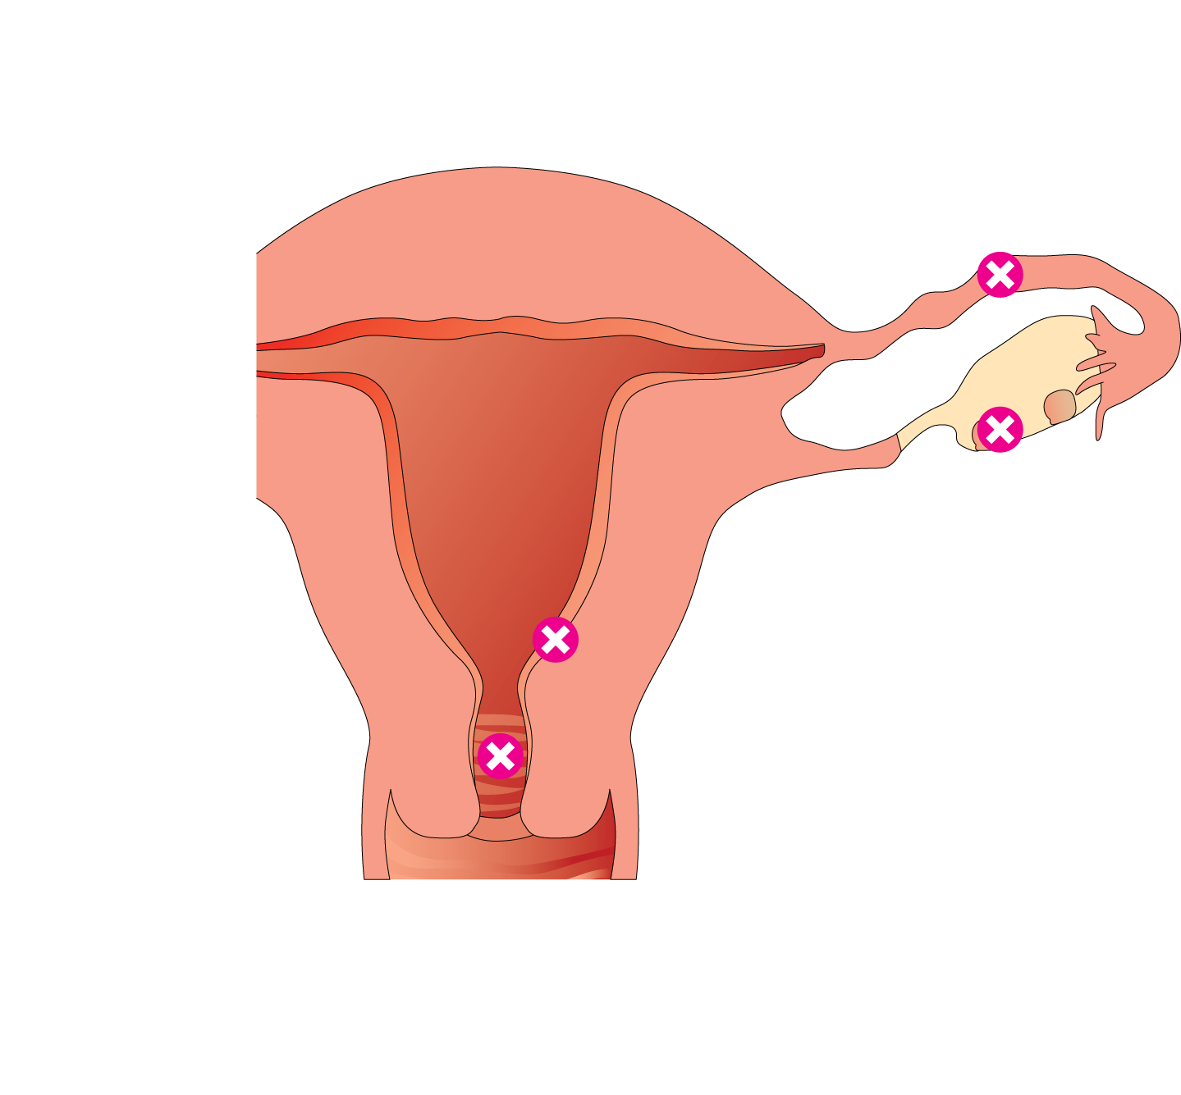
Hormonal contraception: Mechanism of action of combined methods (estrogen + progestogen)
Mechanisms
Inhibiting fallopian cilla
Inhibit transport of ovum
Inhibiting ovulation
No ovum – no conception: COC, Vaginal ring, Patch, Implant
Thickening cervical mucus plug
Prevent entry of sperm
Notes:
If the blood contains relatively high levels of both oestrogen and progestogen throughout the follicular and luteal phase of the cycle, the negative feedback mechanism is triggered.
Without GnRH there is not enough FSH to stimulate the ovary to develop a follicle.
If a follicle is already developed it will be waiting for the mid-cycle surge in LH to cause it to erupt and release the ovum. If the surge does not occur, no ovum will be released.
There are also some minor effects that reinforce the contraceptive effect: these relate to the usual functions of progesterone, altering the consistency of the cervical mucus and causing the endometrium to shed its functional layer.
There is some evidence that progesterone may influence the movement of ova along the fallopian tube.

Slide 46
Short term reversible methods
Combined pills
Progestogen-only pills
Injectables
Vaginal ring
Patch
Emergency pill
Depend on correct use by the woman

Slide 47
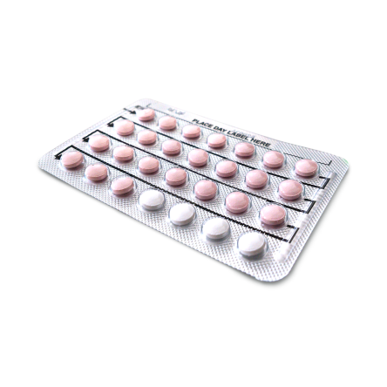
Combined Oral Contraceptive
According to a survey conducted by Bayer in 2009
on 24,320 women aged 15 to 49 years, approximately
66% of European women had already used oral contraceptives.
Currently, approximately 80 million women avoid pregnancy by using pills.

Slide 48
Combined Oral Contraceptive
EVERY DAY
  They comprise 2 female hormones: estrogen and progestogen
  Different pills can provide different benefits
  the benefits vary according to the different types available
  They work by preventing ovulation and by thickening the secretion of cervical mucus
  If used correctly, chances of failure are very low (less than 0.3% per year); however, in real use failure reaches 8%

Slide 49
Additional benefits of the pill
Regularizes the menstrual cycle
Reduces benign ovarian cysts
Reduces the risk of benign breast disease, endometrial cancer and
ovarian cancer
Reduces the rate of ectopic pregnancies and pelvic inflammatory disease
Social and reproductive benefit
Reduces anemia caused by heavy menstrual bleeding
Benefits for skin and hair – some pills
May reduce risk of colon cancer

Slide 50
Common side effects of the pill
These side effects are relatively frequent (1-5% of pill users):
Headaches
Mood swings
Acne
Weight gain
Reduced or increased libido
Painful breasts
Swelling...

Slide 51
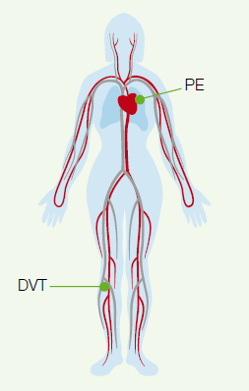
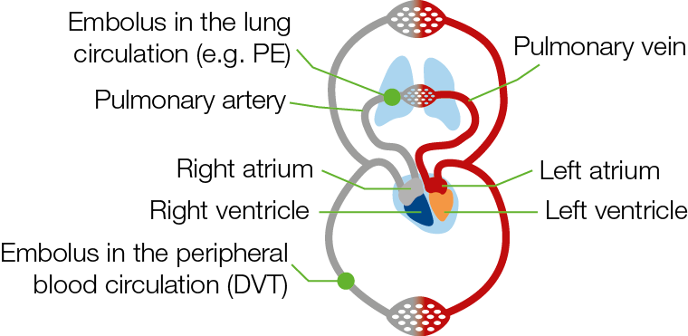
Venous thromboembolism (VTE)
CLASS EFFECT: VTE risk during COC use
VTE comprises 2 related conditions — DVT and PE —
  Deep vein thrombosis (DVT)
    Typically occurs in the lower leg
    Often asymptomatic or associated with minimal symptoms
    Often undiagnosed
  Pulmonary embolism (PE)
    Potentially life-threatening
VTE is fatal in 1–2% of cases¹
Risk factors: personal or family history, age,
obesity, smoking, sedentary lifestyle,
surgery, trauma, immobilization
¹European Medicines Agency. 2001
Notes:
51
Like all products containing estrogens and progestins, COCs are associated with an increased risk of VTE (Class Effect).
VTE includes two related conditions: deep vein thrombosis (DVT) and pulmonary embolism (PE); however, VTE events in rare locations have also been reported, e.g. in retinal, cerebral or mesenteric veins.
DVT is a condition in which a blood clot (thrombus) forms in a deep vein, typically in the large veins in the lower leg, thigh or pelvis. DVT may be clinically asymptomatic or associated with minimal symptoms and may be diagnosed with delay or go entirely undiagnosed.
Post-thrombotic syndrome may occur following DVT, resulting in long-term impairment. The symptoms of post-thrombotic syndrome in the leg can include swelling, pain (aching or cramping), heaviness, itching or tingling and skin ulceration.¹
PE occurs when part of a thrombus in the deep veins breaks away and travels through the bloodstream blocking the arteries in the pulmonary circulation. As with a DVT, a PE may be diagnosed with delay or may go entirely undiagnosed.
PE can lead to persistent perfusion defects and pulmonary hypertension,² may be life-threatening or may have a fatal outcome, e.g., may result in circulatory collapse.
According to a public assessment report on COCs and VTE by the European Medicines Agency, VTE is fatal in 1–2% of cases.³
References
Kahn SR. How I treat postthrombotic syndrome. Blood 2009;114(21):4624–31.
Meyer G, Planquette B, Sanchez O. Long-term outcome of pulmonary embolism. Curr Opin Hematol 2008;15(5):499–503.
European Medicines Agency. European Agency for the Evaluation of Medicinal Products Committee for Proprietary Medicinal Products public assessment report: combined oral contraceptives and venous thromboembolism. 2001. Available from: http://www.lakemedelsverket.se/upload/halso-och-sjukvard/Information%20EMEAAbort%5B1%5D.pdf [Accessed 23 Jan 2012].

Slide 52
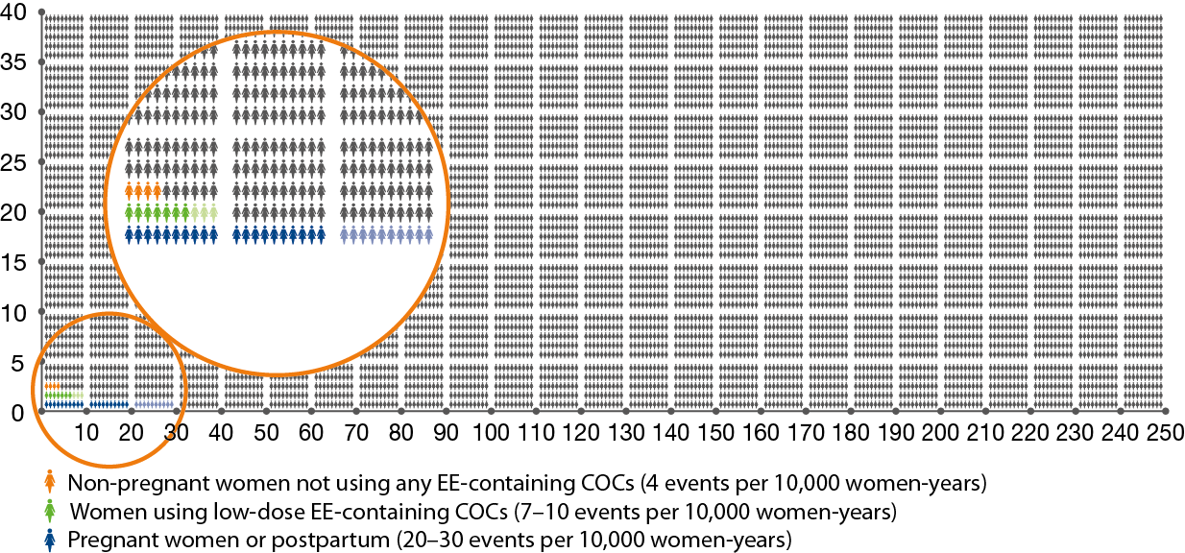
Incidence of venous thromboembolism per 10,000 woman-years¹⁻³
1Dinger et al. Contraception 2007;75(5):344–54; 2Dinger et al. Contraception. 2014;89(4):253-63;
3Heit et al. Ann Intern Med. 2005;143(10):697-706
Notes:
VTE is a rare (7-10 per 10,000 women years),^{1,2} serious adverse event associated with the use of low-dose COCs (containing < 50 µg ethinylestradiol). The most recent data suggest that the frequency of VTE diagnosis is approximately 4 per 10,000 woman years in non-pregnant, non-COC users,¹ and ranges between 20 to 30 per 10,000 woman years during pregnancy or the postpartum period.³ VTE may be fatal in 1-2% of cases.⁴ The risk for VTE in women taking low-dose COCs is therefore lower than the risk associated with pregnancy and following childbirth.
Reference
Dinger JC, Heinemann LA, Kühl-Habich D. The safety of a drospirenone-containing oral contraceptive: final results from the European Active Surveillance Study on oral contraceptives based on 142,475 women-years of observation. Contraception 2007;75(5):344–54.
Dinger J, Bardenheuer K, Heinemann K. Cardiovascular and general safety of a 24-day regimen of drospirenone-containing combined oral contraceptives: final results from the International Active Surveillance Study of Women Taking Oral Contraceptives. Contraception. 2014;89(4):253-263.
Heit JA, Kobbervig CE, James AH, Petterson TM, Bailey KR, Melton LJ, 3rd. Trends in the incidence of venous thromboembolism during pregnancy or postpartum: a 30-year population-based study. Ann Intern Med. 2005;143(10):697-706.
European Medicines Agency. European Agency for the Evaluation of Medicinal Products Committee for Proprietary Medicinal Products public assessment report: combined oral contraceptives and venous thromboembolism. 2001. Available from: http://www.lakemedelsverket.se/upload/halso-och-sjukvard/Information%20EMEAAbort%5B1%5D.pdf. Accessed 1 March 2014.

Slide 53
Risks of death: common life events compared with fatal VTE risk for COC users
Society of Obstetricians and Gynecologists of Canada, Feb 2013: Position Statement: Risk of Diane-35 and VTE

Slide 54
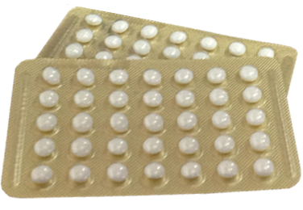
Pills with progestogen only
EVERY DAY
  Also called mini-pills
  They work by altering cervical mucus, some of them
  inhibit ovulation
  They are continuous, i.e. you take 1 tablet a day WITHOUT an interval
  Menstruation may cease altogether or become irregular
  Usually used by breastfeeding women so as not to alter their milk or by those who cannot take estrogen
  Failure rate: 0.3 – 9%

Slide 55
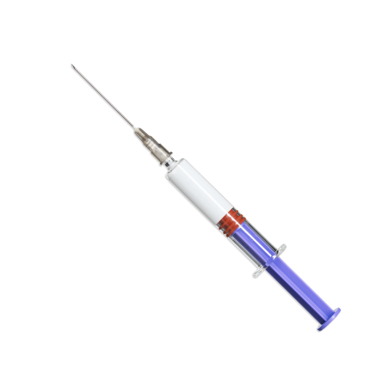
Injectable Contraceptives
1-3 MONTH
  With 2 hormones (estrogen and progestogen)
  They work like the pill
  They have prolonged action, so they only need to be
  administered once monthly, thereby avoiding the risk of
  forgetting, and are more practical
  Modern low-dose injectable contraceptives are quite safe and are generally well tolerated by women who use them and want contraceptive control without affecting their daily routines
  Administer once a month, regardless of menstruation
  Failure rate: 0.05 – 6%

Slide 56
Injectable Contraceptives
3 MONTH
  Progestogen-only
  Administered every 3 months, guarantees protection via inhibition of ovulation and alteration of cervical mucus;
  many women stop having periods while they use them
  This method can be used while breastfeeding
  Administer every 90 days regardless of menstruation
  Fertility may return immediately upon suspension, or may take up to 9 months
  Can cause some women to put on weight
  Failure rate: 0.3 – 6%

Slide 57
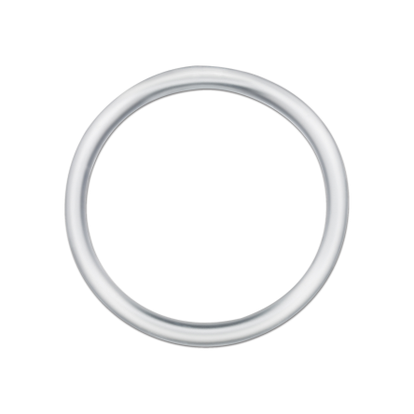
Vaginal Ring
EVERY MONTH
  The vaginal ring is placed inside the vagina for 21 days,
  followed by a 1-week interval, after which the next ring
  is inserted
  It comprises 2 hormones: estrogen and progestogen
  It works in the same way as the contraceptive pill,
  inhibiting ovulation and modifying mucus
  It has the same contraindications and side effects as the pill
  Same risk of thrombosis as combined pills
  Failure rate: 0.3 – 9%

Slide 58
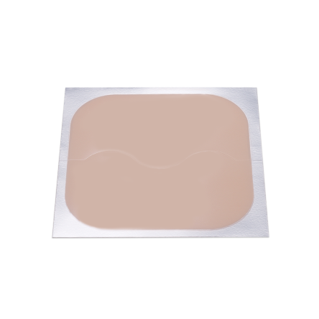
Contraceptive Patch
EVERY WEEK
  3 patches per box, each one stays on the skin for 1 week. After 3 weeks, there is a 7 day patch-free period
  Comprises 2 hormones: estrogen and progestogen
  It works in the same way and has the same contraindications as the pill; the risk of thrombosis is also similar.
  It has to be stuck to the upper inner thigh, inner arm, lower abdomen or buttocks, and the location needs to be rotated
  Failure rate: 0.3 – 9%

Slide 59
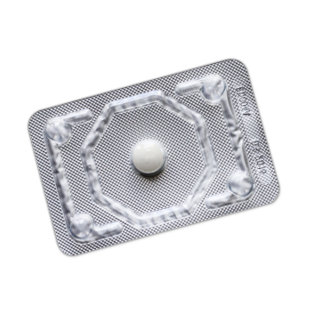
Emergency Pill
ON TIME
  Progestogen-only pill
  Should only be used as an emergency: unprotected
  intercourse, failure of another method, rape
  It is not abortive!
  It can prevent or delay ovulation for several days. If ovulation has already
  occurred it also alters transport of the egg and the sperm in the Fallopian tubes
  The most important effect is the inhibition or delay of ovulation, but it also interferes with the ability of sperm to swim and bind to the egg
  There are single-dose pills or pills that have to be taken twice, at a 12-hour interval
  It should be taken within a maximum of 3 days following intercourse. The closer to the unprotected sexual act, the better the efficacy

Slide 60
Hormone doses of Emergency Pill
High dose of hormone needed: e.g. 1500 µg Levonorgestrel / tablet,
comparable to 50 (!) daily doses of Levonorgestrel in a POP (mini pill)
Therefore only to be used in emergency cases within no more than 72 hours after unprotected intercourse
Not to be used as regular contraceptive method!
Efficacy: Results from a randomized, double-blind clinical study
conducted in 2001 (1) showed that a 1500 microgram single dose of Levonelle 1500 (taken within 72 hours of unprotected sex) prevented 84% of expected pregnancies
¹Lancet 2002; 360: 1803-1810

Slide 61
Efficacy of Emergency contraception decreases considerably the later it is taken
Take it as soon as possible after unprotected intercourse
http://www.nhs.uk/Conditions/contraception-guide/Pages/how-effective-emergency-contraception.aspx

Slide 62
General practitioner prescribing patterns of Emergency Pill
1200
Summer
holidays
1000
800
No. of items prescribed/million patients
600
Christmas
holidays
400
200
Oxfordshire
Rest of England
0
Aug
Apr
Jun
Oct
Apr
Apr
Aug
Aug
Dec
Feb
Jun
Aug
Oct
Dec
Feb
Jun
Oct
Dec
Feb
Apr
Jun
Oct
Dec
Feb
Apr
1995
1996
1997
1998
1999
Shakespeare J et al. BMJ 2000;320:291.
Notes:
The figure shows the prescribing levels for Oxfordshire and England (excluding Oxfordshire). Over the four years the
baseline prescribing of norethisterone in Oxfordshire was about 600 items/month/million population between October
and April. Between November 1995 and November 1998, there was a marked decrease in prescribing,
with a significant difference between these minimums (P<0.01). From April each year, the number of items
prescribed rose rapidly to a maximum in July of about 1100 items/month/million population. There are sub-peaks in
prescribing around the Christmas and new year period in each year. This prescribing pattern is the same as the English
prescribing levels, which are available only for the past two years. In our literature search we found no other papers
describing this phenomenon.
We obtained electronic prescribing analysis and cost information on the number of prescriptions
for norethisterone 5 mg issued by Oxfordshire general practitioners between April 1995 and December
1998. We also obtained prescribing levels for general practitioners in England from February 1997 until January 1999.
This seasonal variation in prescribing cannot be explained by metropathia haemorrhagica or menorrhagia.
The significant reduction in the minimums of the prescribing values suggest that Oxfordshire general practitioners may
have changed their prescribing for menorrhagia. It seems most likely that the seasonal peaks in prescribing were due to
patients wishing to delay menstruation during holidays, particularly summer holidays. We have no information about
whether this prescribing was doctor or patient generated, whether it was the same patients who requested prescriptions
each year, or whether this generated extra workload in consultations or the prescriptions were obtained as repeats.
Since this prescribing pattern for norethisterone was replicated in the national data, the seasonal variation cannot be
due to the relatively affluent and well informed population in Oxfordshire (which is in band 2 of the Jarman score based area
classification of deprivation, where band 1 represents the most affluent of seven bands in total) or to the large student
population of Oxfordshire (7.7% of the Oxfordshire population in the 1991 census, compared with the English average of 4.3%).
If this seasonal prescribing is to delay periods during holidays this would make norethisterone a "lifestyle drug" that is, "a
pharmaceutical product characterised as improving quality of life rather than alleviating or curing disease."4 Whether this
lifestyle or convenience prescribing is appropriate for the NHS is open for debate. Fortunately, norethisterone is a cheap
drug at £7.20/100 5mg tablets5 (unlike sildenafil), has few side effects and most patients who take it are likely to be
paying prescription costs.

Slide 63
Long acting methods
Copper IUD
Hormonal IUD or IUS
Hormonal implant
They do not depend on the patient!
They must be inserted by a well-trained healthcare professional.

Slide 64
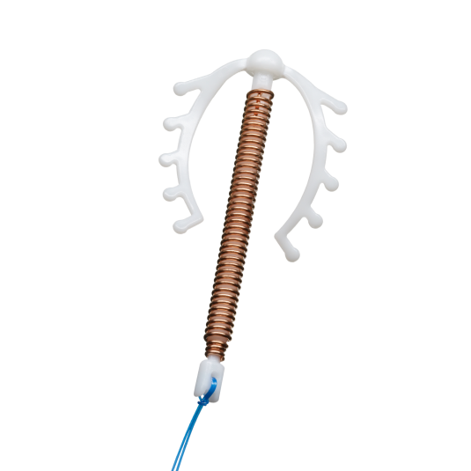
Copper Intrauterine Device (IUD)
5-10 YEARS
  It is a small plastic device coated in copper, usually in the
  shape of the letter T
  It does not contain any hormones
  It is inserted inside the womb by a doctor. It releases the copper,
  making it difficult for sperm to pass, for a period of up to 10 years.
  An IUD is a safe and reversible method. In some women,
  it can increase menstrual bleeding
  It is not abortive
  Fertility returns after removal
  It can be used when breastfeeding
  Failure rate: 0.6 to 0.8%

Slide 65
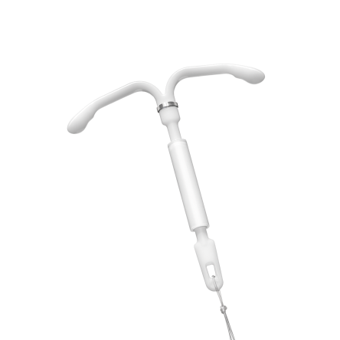
Hormonal IUD or Intrauterine System (IUS)
3-5 YEARS
  It is a small device in the shape of the letter T, with a
  progestogen-containing cylinder
  Inside the womb, it releases small amounts of hormone for
  a period of up to 5 years
  It is a reversible method; fertility returns quick after removal
  It can be used during breastfeeding and by women who
  cannot use estrogen
  The IUS lessens the amount of menstrual bleeding, makes it shorter and in some cases it is absent
  It can also be used for other indications, such as heavy menstrual bleeding, in hormone replacement therapy, protecting against excessive growth of the
  womb layer.
  Failure rate: 0.2%

Slide 66

Hormonal Implant
3-5 YEARS
  This is a small silicone stick that contains a hormone (progestogen)
  It works by inhibiting ovulation, modifying cervical mucus
  and altering the endometrium
  The stick is inserted under the skin of the arm by a doctor
  and remains in place for up to 3 years, after which it has to be removed.
  Some women can have reduced or absent menstrual bleeding during use
  It can be used when breastfeeding and by women who cannot take estrogen
  Failure rate: 0.05%

Slide 67
Permanent methods
Sterilization
Vasectomy
Tubal implant
Procedures carried out by well-trained healthcare providers

Slide 68

Sterilization
PERMANENT
  Surgery performed on women, during which the Fallopian
  tubes are interrupted, preventing the egg from reaching
  a sperm
  As is it irreversible, it is important for the woman to be
  sure that she will not change her mind afterwards; check with your doctor whether it is the right time to choose this option
  Failure rate: 0.5%

Slide 69
Vasectomy
PERMANENT
  This is a permanent form of surgery on men, during which the ductus deferens is interrupted, preventing sperm from reaching the seminal vesicle and being ejaculated with the semen
  The man can continue to have erections and ejaculations,
  without interfering with sexual intercourse
  It can eventually be reverted with surgery, but success is not guaranteed
  Failure rate: 0.1 – 0.15%

Slide 70
Tubal Implant
PERMANENT
  Flexible devices made of stainless steel in the form of coils
  that are inserted inside the Fallopian tubes via hysteroscopy
  (procedure under video control)
  They can be inserted without anesthesia or in hospital under sedation
  The coils block the Fallopian tubes and prevent sperm from coming into contact with the eggs
  It is irreversible as it would be difficult to unblock the tubes afterwards
  No cuts or scars
  After insertion it takes approximately 3 months for the Fallopian tubes to become completely blocked
  Failure rate: 0.05%

Slide 71
Efficacy of contraceptive methods during first year of use
Low efficacy
High efficacy if used correctly
Very high efficacy
if used correctly
as commonly used
Failure rate [%]
Trussell J. Contraceptive Efficacy. In Hatcher RA, Trussell J, Nelson AL, Cates W, Kowal D, Policar M. Contraceptive Techology:
Twentieth Revised Edition. New York NY: Ardent Media, 2011

Slide 72
Chapter 4:
The most relevant Factors for
Contraceptive Counselling

Slide 73
What do women think about and expect from contraception?
Bayer conducted a big global Market Research Study (AIMS) asking
>6000 women (15 – 49 y)
Australia, Asia, Europe, North/South Americas
All women currently use, or are open to using hormonal contraception

Slide 74
AIMS: Current use of contraceptive methods
Global total
Women were allowed to select more than one answer, therefore responses will sum to over 100%

Slide 75
AIMS: Factors influencing contraceptive choice
Global total
n=6,179
Women were allowed to select more than one answer, therefore responses will sum to over 100%

Slide 76
Efficacy of contraceptive methods during first year of use
Low efficacy
High efficacy if used correctly
Very high efficacy
if used correctly
as commonly used
Failure rate [%]
Trussell J. Contraceptive Efficacy. In Hatcher RA, Trussell J, Nelson AL, Cates W, Kowal D, Policar M. Contraceptive Techology:
Twentieth Revised Edition. New York NY: Ardent Media, 2011

Slide 77
AIMS: Reasons for choosing an IUS
Global total
Q1b. Why did you choose to go on a hormonal coil (intrauterine system)?

Slide 78
AIMS: Reasons for current use of an OC
Global total
n=2,709
women
using an
oral
contraceptive
Women were allowed to select more than one answer, therefore responses will sum to over 100%

Slide 79
AIMS: Likelihood to switch to OC with claims like:
Global total
Factors
More natural option/uses hormones produced naturally
Better regulated periods
Does not reduce sexual desire/libido
Fewer side effects like headache, cramps, etc.
Lightening of heavy bleeding
n=6,179

Slide 80
AIMS: Diagnosis with gynecological conditions
Global total
Women were allowed to select more than one answer, therefore responses will sum to over 100%
n=6,179

Slide 81
AIMS: Discussion of menstrual symptoms with HCPs
Global total
n=6,179
Women were allowed to select more than one answer, therefore responses will sum to over 100%

Slide 82
AIMS: Top of mind improvements for contraceptives
n=776

Slide 83
First ask a few questions
Age
Relationship (regular partner / multiple partners)
Menstrual history
Previous contraception
Previous Medical History: current, past, STIs
Drug History
Contraindications to hormonal contraception:
  smoking (+ age >35),
  family or own history of clots
  breast/cervical cancer
  Migraine with aura
“First, I need to ask a few questions about your health and relationships to decide which methods are most appropriate...”

Slide 84
Get an insight into what they like and what they know
Ask them what they are hoping to get out of the consultation and what they know so far (let the patient lead the consultation)
Try to determine which type of method will be most appropriate e.g.
  Any preferences
  Preferred delivery
  Ability to remember to take pills
  Like injections

Slide 85
Describe methods and provide additional information
Describe a method in more detail
How it works
Treatment course
Side effects / risks (and effects on menstrual cycles)
Positives vs. negatives
Briefly discuss other options
Mention alternatives
Ending
Let think about it and advise them they can return again if they wish to discuss other options
Summarize and handout leaflets and provide links to websites (your-life.com, WHO medical eligibility criteria for contraceptives, planned parenthood etc…..)

