Slide 1
Straight to the Point: Talking IUC Using evidence to dispel the myths around intrauterine contraception and pelvic inflammatory disease Updated Oct 2017

Slide 2
INTRA PID slides: Terms of use
If any adjustments are made to the original, neither Bayer AG nor the INTRA group can accept responsibility whatsoever for their content.
If you make changes you should not use the INTRA slide template.
When using any of these slides, even if you modify them in some way, please acknowledge to your audience that the original slides were provided by the INTRA group:
“The global INTRA group is a panel of independent physicians with expert interest in intrauterine contraception. Formation of the INTRA group and its ongoing work is supported by Bayer AG”.
You may select any combination of slides to present on to others; however, the context of the slides should be maintained wherever possible.
Please be aware that recommendations and regulations around communications on contraception as well as product labels vary globally, and ensure that the content and recommendations included in the slides are aligned to the local regulations and product labels of the country where you are presenting.
Notes:
Speaker notes:
This slide summarises the agreed terms of use of the Educational Slide Kit contents.

Slide 3
The Global INTRA Group
INTRA group: Intrauterine coNtraception: Translating Research into Action
A panel of independent physicians with expert interest in intrauterine contraception
Purpose: To encourage more widespread use of IUC methods in a broad range of women through medical education
Dr Brian Hauck,
Canada
Prof Nikki Zite,
USA
Dr Tina Peers,
UK
Dr Pamela Lotke,
USA
Dr Josefina Lira,
Mexico
Prof Kai Bühling,
Germany
Dr Carolina Vieira,
Brazil
Formation of the INTRA group and its ongoing work is supported by Bayer AG

Slide 4
Introduction
Intrauterine contraception (IUC) is a highly effective, reversible method of contraception¹
Studies involving women of all ages, parity and risk of sexually transmitted infection (STI) show that the risk of pelvic inflammatory disease (PID) with IUC use is low²⁻¹⁰
1. Trussell J. Contraception 2011;83:397−404. 6. Papic M, et al. Womens Health Issues 2015;25(1):22-7.
2. Sufrin CB, et al. Obstet Gynecol 2012;120(6):1314-21. 7. Farley TMM, et al. Lancet 1992;339:785-8.
3. Birgisson NE, et al. J Womens Health (Larchmt) 2015;24(5):354-9. 8. Turok D, et al. Am J Obstet Gynecol 2016;215:599
4. Gemzell-Danielsson K, et al. PLoS ONE 2015. 9. Gemzell-Danielsson K, et al. Eur J Obstet Gynecol RB 2017;210:22-28.
5. Bayer LL, et al. Contraception 2012;86(5):443-451. 10. Gemzell-Danielsson K, et al. Contraception 2016;93(6):507-12.
Notes:
Speaker notes:
Intrauterine contraception (IUC) is a highly effective, reversible method of contraception.¹
Studies involving women of all ages, parity and risk of sexually transmitted infection (STI) show that the risk of pelvic inflammatory disease (PID) with IUC use is low.²⁻¹⁰
References:
Trussell J. Contraceptive failure in the United States. Contraception 2011;83:397−404.
Sufrin CB, et al. Neisseria gonorrhea and Chlamydia trachomatis screening at intrauterine device insertion and pelvic inflammatory disease. Obstet Gynecol 2012;120(6):1314-21.
Birgisson NE, et al. Positive Testing for Neisseria gonorrhea and Chlamydia trachomatis and the Risk of Pelvic Inflammatory Disease in IUD Users. J Womens Health (Larchmt) 2015;24(5):354-9.
Gemzell-Danielsson K, et al. The effect of age, parity and body mass index on the efficacy, safety, placement and user satisfaction associated with two low-dose levonorgestrel intrauterine contraceptive systems; subgroup analysis of data from a phase III trial. PLoS ONE 2015.
Bayer LL, et al. Adolescent experience with intrauterine device insertion and use: a retrospective cohort study. Contraception 2012;86(5):443-451.
Papic M, et al. Same day intrauterine device placement is rarely complicated by pelvic infection. Womens Health Issues 2015;25(1):22-7.
Farley TMM, Rosenberg MJ, Rowe PJ, et al. Intrauterine devices and pelvic inflammatory disease: an international perspective. Lancet 1992;339:785-8.
Turok D, et al. A prospective assessment of pelvic infection risk following same-day sexually transmitted infection testing and levonorgestrl intrauterine system placement. Am J Obstet Gynecol 2016;215:599
Gemzell-Danielsson K, et al. Evaluation of a new, low-dose levonorgestrel intrauterine contraceptive system over 5 years of use. Eur J Obstet Gynecol RB 2017;210:22-28.
Gemzell-Danielsson K, et al. A Phase III , single-arm study of LNG-IUS 8, a low-dose levonorgestrel intrauterine contraception system (total content 13.5 mg) in postmenarcheal adolescents. Contraception 2016;93(6):507-12

Slide 5
Despite high-quality evidence, inaccurate perception of PID risk with IUC continues to act as a deterrent to its use, particularly in younger and nulliparous women^{1,2}
Black K, et al. Contraception 2013; 88: 650–656.
Black K, et al. Eur J Contracept Reprod Health Care 2012;17:340–350.
Notes:
Speaker notes:
Although there is a large quantity of evidence to show that risk of PID with IUC is low, the inaccurate perception of risk of PID with IUC continues to act as a deterrent to its use, particularly in younger and nulliparous women^{1,2}
References;
Black K, et al. Global survey of healthcare practitioners’ beliefs and practices around intrauterine contraceptive method use in nulliparous women. Contraception 2013; 88: 650–656.
Black K, et al. A review of barriers and myths preventing the more widespread use of intrauterine contraception in nulliparous women. Eur J Contracept Reprod Health Care 2012;17:340–350.

Slide 6
The misperception of PID risk with IUC is perpetuated by multiple factors¹
Diagnosis of PID is regarded as complex¹
PID risk in control populations is difficult to assess¹
PID is often over-diagnosed^{2,3}
It may be easy to blame PID symptoms on an IUC⁴
Image: Microscopic view of chlamydia. Credit: Stocktrek Images
Inconsistencies around PID definition used, criteria for diagnosis, study populations and presentation of incidence limit clear comparison and conclusions¹
1. Meirik O. Review article. Contraception 2007;75(6 Suppl):S41-S47.
2. Black K, et al. Eur J Contracept Reprod Health Care 2012;17:340–350.
3. Workowski KA, Bolan GA, Centers for Disease Control, Prevention. MMWR Recomm Rep 2015;64:1–37.
4. Black K, et al. Eur J Contracept Reprod Health Care 2012;17:340–350.
Notes:
Speaker notes:
The misperception of PID risk with IUC is perpetuated by multiple factors.¹
Diagnosis of PID is regarded as complex.¹
PID risk in control populations is difficult to assess.¹
It may be easy to blame PID symptoms on an IUC.²
Inconsistencies around PID definition used, criteria for diagnosis, study populations and presentation of incidence limit clear comparison and conclusion.¹
References:
Meirik O. Intrauterine devices – upper and lower genital tract infections. Review article. Contraception 2007;75(6 Suppl):S41-S47.
Brunham RC, et al. Pelvic inflammatory disease. Med 2015;372:2039–48.
Workowski KA, Bolan GA, Centers for Disease Control, Prevention. Sexually transmitted diseases treatment guidelines, 2015. MMWR Recomm Rep 2015;64:1–37.
Black K, et al. A review of barriers and myths preventing the more widespread use of intrauterine contraception in nulliparous women. Eur J Contracept Reprod Health Care 2012;17:340–350.

Slide 7
However, there are clear diagnostic criteria for PID¹
Presumptive treatment for PID should be initiated in sexually active young women and other women at risk for STDs if they are experiencing…¹
Pelvic or lower abdominal pain with no other identified cause of illness other than PID
1. Cervical motion tenderness
2. Uterine tenderness 3. Adnexal tenderness
PLUS one of the following clinical criteria on pelvic examination
Additional criteria to enhance specificity:¹
oral temperature >101°F or >38.3°C
abnormal cervical mucopurulent discharge/cervical friability
elevated WBC erythrocyte sedimentation rate, or C-reactive protein
lab documentation of cervical infection with N. gonorrhoeae or C. trachomatis
1. Centers for Disease Control and Prevention 2015 STD Treatment Guidelines. Pelvic Inflammatory Disease. Accessed at: http://www.cdc.gov/std/tg2015/pid.htm on 12th April 2016.
Notes:
Speaker notes:
The Center for Disease Control and Prevention (CDC) outlines clear diagnostic criteria for PID.¹
Criteria for initiation of presumptive treatment for PID includes:
pelvic or lower abdominal pain with no other identified cause of illness other than PID;
PLUS one of the following clinical criteria on pelvic examination:
cervical motion tenderness;
uterine tenderness;
adnexal tenderness.
Reference:
Centers for Disease Control and Prevention 2015 STD Treatment Guidelines. Pelvic Inflammatory Disease. Accessed at: http://www.cdc.gov/std/tg2015/pid.htm on 12th April 2016.

Slide 8
If diagnosed at an early stage, PID can be treated effectively, even with IUC in place^{1,2}
PID treatment regimens must provide empiric, broad spectrum coverage of likely pathogens³*
*(Including N. gonorrhoeae and C. trachomatis)
Treatment should be started quickly to prevent long-term sequelae³
In mild or moderate PID, parenteral and oral regimens appear to have similar efficacy³
Consider local microbial sensitivity patterns, availability, cost, and patient acceptance^{3,4}
Black A. Obstet Gynaecol Can 2016;38(2):182-222
Turok DK, et al. Am J Obstet Gynecol 2016;215:599.e1-6.
Centers for Disease Control and Prevention 2015 STD Treatment Guidelines. Pelvic Inflammatory Disease. Accessed at: http://www.cdc.gov/std/tg2015/pid.htm on 12th April 2016
2012 European Guideline for the Management of Pelvic Inflammatory Disease. Accessed at: http://www.iusti.org/regions/europe/pdf/2012/PID_Treatment_Guidelines-Europe2012v5.pdf on 12th April 2016
Notes:
Speaker notes:
If diagnosed at an early stage, PID can be treated easily and effectively.¹
PID treatment regimens must provide empiric, broad spectrum coverage of likely pathogens (including N. gonorrhoeae and C. trachomatis).²
Treatment should be started quickly to prevent long-term sequelae.²
In mild or moderate PID, parenteral and oral regimens appear to have similar efficacy.²
Consider local microbial sensitivity patterns, availability, cost, and patient acceptance.^{2,3}
References:
Black A. et al. Canadian Contraception Consensus (Part 3 of 4): Chapter 7 – Intrauterine Contraception. Obstet Gynaecol Can 2016;38(2):182-222.
Centers for Disease Control and Prevention 2015 STD Treatment Guidelines. Pelvic Inflammatory Disease. Accessed at: http://www.cdc.gov/std/tg2015/pid.htm on 12th April 2016.
2012 European Guideline for the Management of Pelvic Inflammatory Disease. Accessed at: http://www.iusti.org/regions/europe/pdf/2012/PID_Treatment_Guidelines-Europe2012v5.pdf on 12th April 2016.

Slide 9
Helping HCPs overcome PID risk as a barrier to IUC use
This review aims to:
Address HCP questions or concerns about PID in women using IUC
Help HCPs disseminate this information to colleagues who may have questions or concerns
By:
Evaluating and sharing the most recent clinical data showing the low risk of PID with IUC use
Exploring the impact of population size, nature and timing of follow-up, and PID definition on PID outcomes data
Notes:
Speaker notes:
This review aims to:
Address HCP questions or concerns about PID in women using IUC;
Help HCPs disseminate this information to colleagues who may have questions or concerns.
By
Evaluating and sharing the most recent clinical data showing the low risk of PID with IUC use;
Exploring the impact of population size, nature and timing of follow-up, and PID definition on PID outcomes data.

Slide 10
Key content
Approach to this review
Publications under discussion
Review papers
Clinical trials
Key findings regarding incidence of PID
Summary data
Factors influencing the incidence of PID
Notes:
Speaker notes:
This slide is hidden but may be ‘un-hidden’ if felt to be a useful signposting slide.

Slide 11
Our approach to this Data Review
An online search was conducted for papers published between 2010 - 2015 using the following key words:
“Long-acting reversible contraception (LARC)”
“Intrauterine contraception (IUC)”
“Pelvic inflammatory disease (PID)”
“Established generic and proprietary IUC devices”
The INTRA group was asked to propose additional papers that would inform the review
In 2017, a repeat literature search was carried out, using the same key words, to identify additional studies that would update the review
This data review has been updated in 2017
Notes:
Speaker notes:
The INTRA group conducted an online search for papers published between 2010 - 2015 using the following key words:
“Long-acting reversible contraception (LARC)”
“Intrauterine contraception (IUC)”
“Pelvic inflammatory disease (PID)”
“Established generic and proprietary IUC devices”
The INTRA group also proposed additional papers that would inform the review.

Slide 12
Resulting publications were screened and key studies and reviews selected
Studies with a global spread of data regarding incidence of PID
Variety of study population (age, parity, risk of STI)
Different types of study (observation, retrospective, phase III)
Notes:
Speaker notes:
Resulting publications were screened and key studies and reviews selected.
Efforts were made to include studies that provided:
a global spread of data regarding incidence of PID;
a variety of study population (age, parity, risk of STI);
different types of study (observation, retrospective, phase III).

Slide 13
Findings of the PID Review
Review articles
Cite and discuss both historic and recent data showing the incidence of PID to be low¹⁻⁶
Recent large studies
Show the incidence of PID in women using IUC to be low, irrespective of age, parity, STI risk, and timing of STI screening and placement⁷⁻¹¹
Recent small studies
Support the findings of large-scale studies in specific populations¹²⁻¹⁴
Meirik O. Contraception 2007;75(6 Suppl):S41-S47.
Lyus R, et al. Contraception 2010;81(5):367-71.
Blumenthal PD, et al. Hum Reprod Update 2011;17(1):121-37.
Carr, et al. J Adolesc Health 2013;52(4):S22-S28.
Jatlaoui TC, et al. Contraception 2016;94:701-712.
Jatlaoui TC, et al. Contraception 2016;95(1):17-39.
Sufrin CB, et al. Obstet Gynecol 2012;120(6):1314-21.
Birgisson NE. et al. J Womens Health (Larchmt) 2015;24(5):354-9.
Gemzell-Danielsson K. et al. PLoS ONE 2015.
Turok D, et al. Am J Obstet Gynecol 2016;215:599.
Gemzell-Danielsson K, et al. Eur J Obstet Gynecol RB 2017;210:22-28.
Bayer LL, et al. Contraception 2012;86(5):443-451.
Papic M, et al. Womens Health Issues 2015;25(1):22-7.
Gemzell-Danielsson K, et al. Contraception 2016;93(6):507-12.
Notes:
Speaker notes:
The PID Review includes review articles, recent large studies and recent small studies.
These publications:
Cite and discuss both historic and recent data showing the incidence of PID to be low;¹⁻⁶
Show the incidence of PID in women using IUC to be low, irrespective of age, parity, STI risk, and timing of STI screening and placement;⁷⁻¹¹
Support the findings of large-scale studies in specific populations.¹²⁻¹⁴
References:
Meirik O. Intrauterine devices – upper and lower genital tract infections. Review article. Contraception 2007;75(6 Suppl):S41-S47.
Lyus R, et al. Use of the Mirena LNG-IUS and Paragard CuT380A intrauterine devices in nulliparous women. Contraception 2010;81(5):367-71.
Blumenthal PD, et al. Strategies to prevent unintended pregnancy: increasing use of long-acting reversible contraception. Hum Reprod Update 2011;17(1):121-37.
Carr, et al. Intrauterine Devices and Pelvic Inflammatory Disease Among Adolescents. J Adolesc Health 2013;52(4):S22-S28.
Jatlaoui TC, et al. The safety of intrauterine contraception initiation among women with current asymptomatic cervical infections or at increased risk of sexually transmitted infections. Contraception 2016;94:701-712.
Jatlaoui TC, et al. The safety of intrauterine devices amongst women: a systematic review. Contraception 2016;95(1):17-39.
Sufrin CB, et al. Neisseria gonorrhea and Chlamydia trachomatis screening at intrauterine device insertion and pelvic inflammatory disease. Obstet Gynecol 2012;120(6):1314-21.
Birgisson NE. et al. Positive Testing for Neisseria gonorrhea and Chlamydia trachomatis and the Risk of Pelvic Inflammatory Disease in IUD Users. J Womens Health (Larchmt) 2015;24(5):354-9.
Gemzell-Danielsson K. et al. The effect of age, parity and body mass index on the efficacy, safety, placement and user satisfaction associated with two low-dose levonorgestrel intrauterine contraceptive systems; subgroup analysis of data from a phase III trial. PLoS ONE 2015.
Turok D, et al. A prospective assessment of pelvic infection risk following same-day sexually transmitted infection testing and levonorgestrl intrauterine system placement. Am J Obstet Gynecol 2016;215:599
Gemzell-Danielsson K, et al. Evaluation of a new, low-dose levonorgestrel intrauterine contraceptive system over 5 years of use. Eur J Obstet Gynecol RB 2017;210:22-28.
Bayer LL, et al. Adolescent experience with intrauterine device insertion and use: a retrospective cohort study. Contraception 2012;86(5):443-451.
Papic M, et al. Same day intrauterine device placement is rarely complicated by pelvic infection. Womens Health Issues 2015;25(1):22-7.
Gemzell-Danielsson K, et al. A Phase III , single-arm study of LNG-IUS 8, a low-dose levonorgestrel intrauterine contraception system (total content 13.5 mg) in postmenarcheal adolescents. Contraception 2016;93(6):507-12.

Slide 14
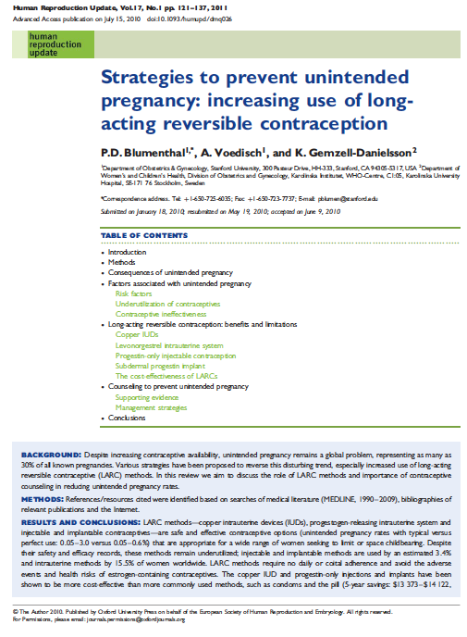
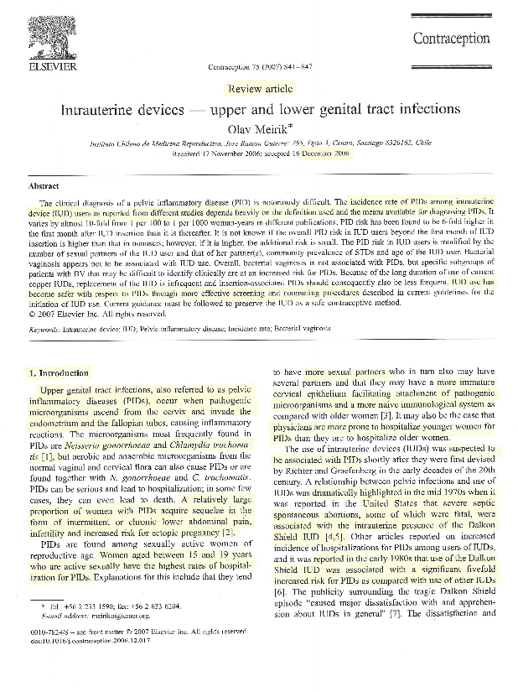
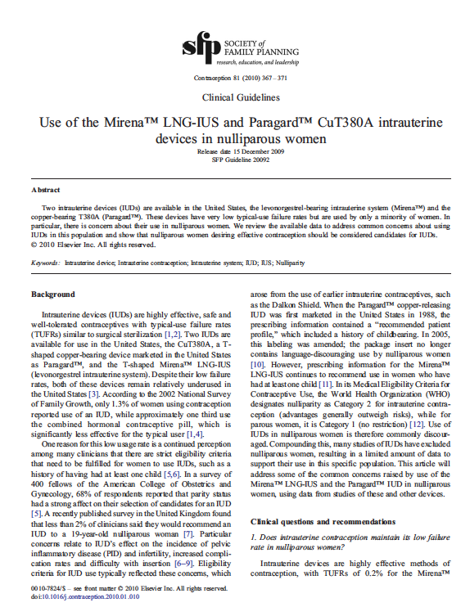
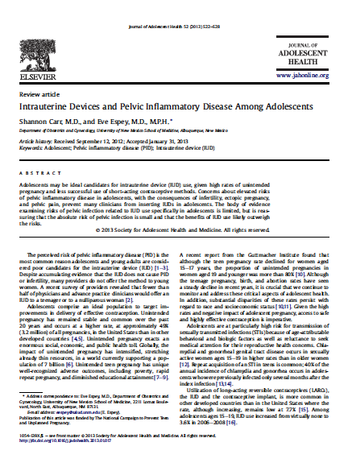
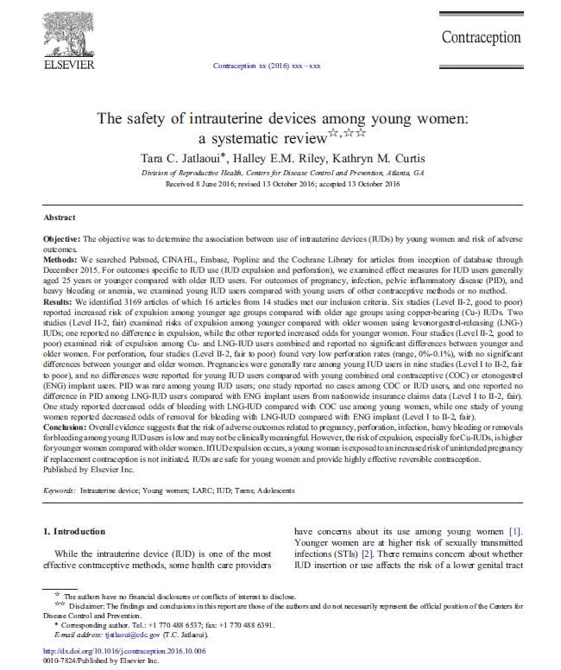
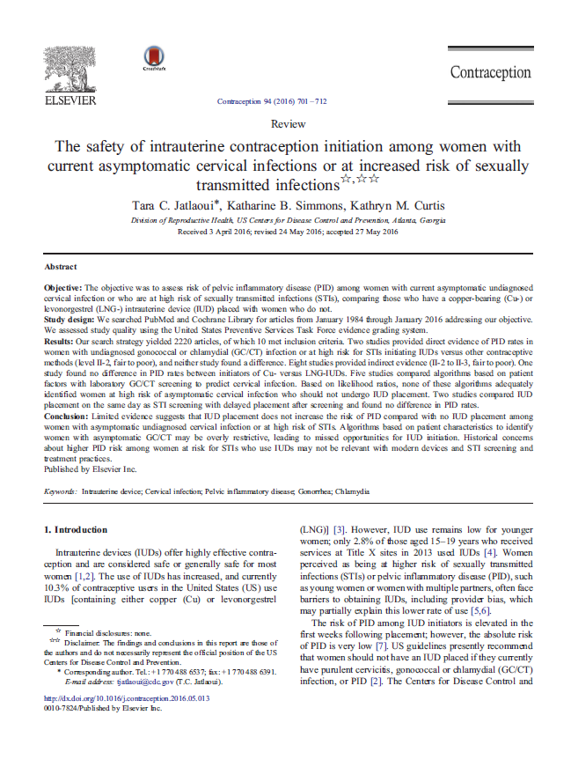
Review articles
Meirik O. Contraception 2007;75(6 Suppl):S41-S47
Lyus R, et al. Contraception 2010;81(5):367-71
Blumenthal PD, et al. Hum Reprod Update 2011;17(1):121-37
Carr S, et al. J Adolesc Health 2013;52(4):S22-S28
Jatlaoui TC, et al. Contraception 2016;94:701-712.
Jatlaoui TC, et al. Contraception 2016;95(1):17-39.
Notes:
Speaker notes:
Six review articles were included in the updated review; the two most recent focused on the safety of intrauterine contraception in young women and those women either diagnosed with sexually transmitted infection of at increased risk of sexually transmitted infection.
References:
Meirik O. Intrauterine devices – upper and lower genital tract infections. Review article. Contraception 2007;75(6 Suppl):S41-S47.
Lyus R, et al. Use of the Mirena LNG-IUS and Paragard CuT380A intrauterine devices in nulliparous women. Contraception 2010;81(5):367-71.
Blumenthal PD, et al. Strategies to prevent unintended pregnancy: increasing use of long-acting reversible contraception. Hum Reprod Update 2011;17(1):121-37.
Carr S, et al. Intrauterine Devices and Pelvic Inflammatory Disease Among Adolescents. J Adolesc Health 2013;52(4):S22-S28.
Jatlaoui TC, et al. The safety of intrauterine contraception initiation among women with current asymptomatic cervical infections or at increased risk of sexually transmitted infections. Contraception 2016;94:701-712.
Jatlaoui TC, et al. The safety of intrauterine devices amongst women: a systematic review. Contraception 2016;95(1):17-39.

Slide 15
All review articles state the incidence of PID to be low¹⁻⁶
The authors conclude that there is no evidence to support beliefs that…¹⁻⁴
A recent review also highlighted no difference in PID risk in IUC (LNG-IUS) users when compared with those using combined oral contraception (COC) or an implant (ENG)⁶
Nulliparous women are at greater risk of PID with IUC than parous women²
IUC increases the risk of more severe PID or greater likelihood of long-term sequelae, such as infertility^{2,4}
1. Meirik O. Contraception 2007;75(6 Suppl):S41-S47
2. Lyus R, et al. Contraception 2010;81(5):367-71
3. Blumenthal PD, et al. Hum Reprod Update 2011;17(1):121-37
4. Carr S, et al. J Adolesc Health 2013;52(4):S22-S28
5. Jatlaoui TC, et al. Contraception 2016;94:701-712.
6. Jatlaoui TC, et al. Contraception 2016;95(1):17-39.
Notes:
Speaker notes:
All review articles state the incidence of PID to be low.¹⁻⁶
The review authors also concluded there to be no evidence to show:
Nulliparous women are at greater risk of PID with IUC than parous women;²
IUC increases the risk of more severe PID or greater likelihood of long-term sequelae, such as infertility;^{2,4}
References:
Meirik O. Intrauterine devices – upper and lower genital tract infections. Review article. Contraception 2007;75(6 Suppl):S41-S47.
Lyus R, et al. Use of the Mirena LNG-IUS and Paragard CuT380A intrauterine devices in nulliparous women. Contraception 2010 May;81(5):367-71.
Blumenthal PD. et al. Strategies to prevent unintended pregnancy: increasing use of long-acting reversible contraception. Hum Reprod Update 2011;17(1):121-37.
Carr S, et al. Intrauterine Devices and Pelvic Inflammatory Disease Among Adolescents. Journal of Adolescent Health 2013;52(4):S22-S28.
Jatlaoui TC, et al. The safety of intrauterine contraception initiation among women with current asymptomatic cervical infections or at increased risk of sexually transmitted infections. Contraception 2016;94:701-712.
Jatlaoui TC, et al. The safety of intrauterine devices amongst women: a systematic review. Contraception 2016;95(1):17-39.

Slide 16
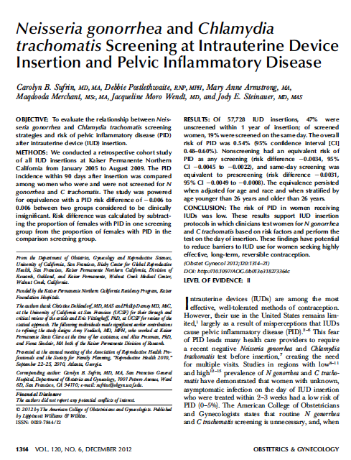
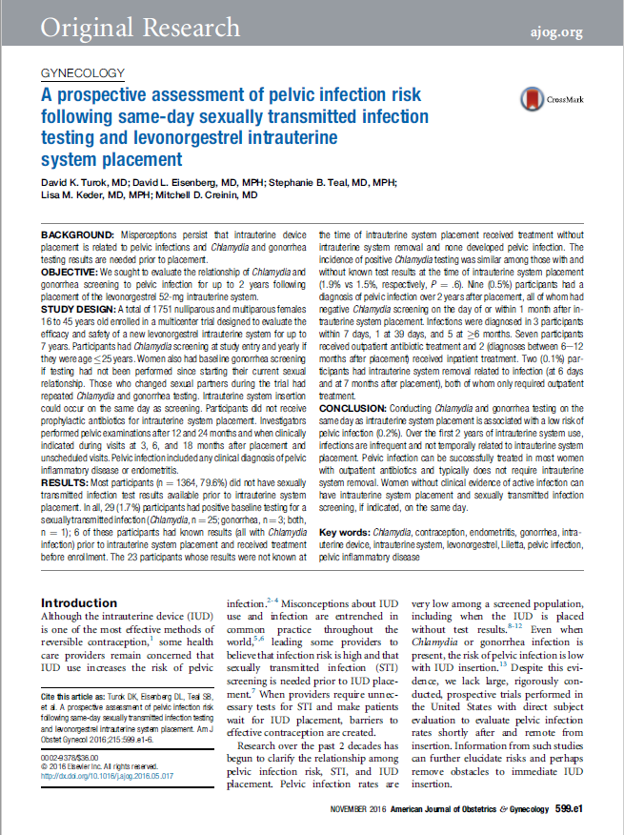
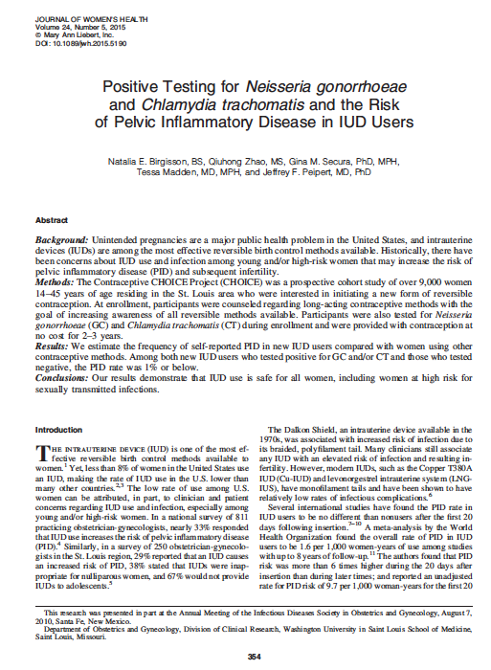
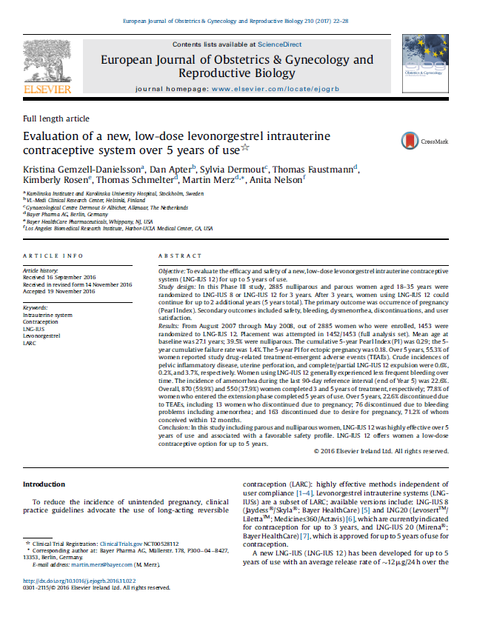
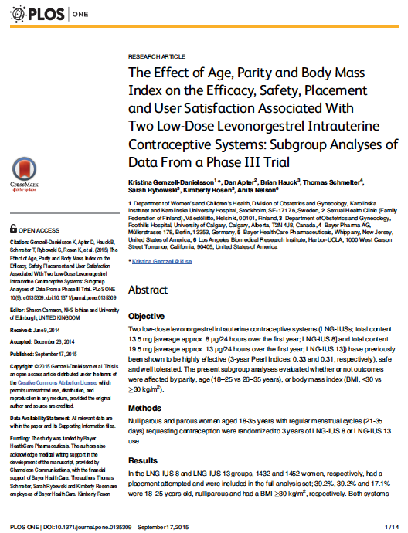
Recent large studies
Sufrin CB, et al. Obstet Gynecol 2012;120(6):1314-21.
Birgisson NE, et al. J Womens Health (Larchmt) 2015;24(5):354-9.
Gemzell-Danielsson K, et al. PLoS ONE 2015.
Turok D, et al. Am J Obstet Gynecol 2016;215:599
Gemzell-Danielsson K, et al. Eur J Obstet Gynecol RB 2017;210:22-28.
Notes:
Speaker notes:
Five recently completed, large-scale studies, involving a total of more than 60,000 patients were included in the review.¹⁻³
References;
Sufrin CB, et al. Neisseria gonorrhea and Chlamydia trachomatis screening at intrauterine device insertion and pelvic inflammatory disease. Obstet Gynecol 2012;120(6):1314-21.
Birgisson NE, et al. Positive Testing for Neisseria gonorrhoeae and Chlamydia trachomatis and the Risk of Pelvic Inflammatory Disease in IUD Users. J Womens Health (Larchmt) 2015;24(5):354-9.
Gemzell-Danielsson K, et al. The effect of age, parity and body mass index on the efficacy, safety, placement and user satisfaction associated with two low-dose levonorgestrel intrauterine contraceptive systems; subgroup analysis of data from a phase III trial. PLoS ONE 2015.
Turok D, et al. A prospective assessment of pelvic infection risk following same-day sexually transmitted infection testing and levonorgestrel intrauterine system placement. Am J Obstet Gynecol 2016;215:599
Gemzell-Danielsson K, et al. Evaluation of a new, low-dose levonorgestrel intrauterine contraceptive system over 5 years of use. Eur J Obstet Gynecol RB 2017;210:22-28.

Slide 17
Five recent studies show the incidence of PID with IUC to be <1%¹⁻⁵
Overall incidence of PID (%)
All five studies evaluated PID events in large study populations and involved comprehensive
follow-up¹⁻⁵
5
4
3
Incidence of PID
2
PID was a primary endpoint in 3 out of 5 studies^{1,2,5}
0.54%
(n=57,728)
0.46% (n=4,371)
0.42%
(n=2,884)
0.5% (n=1,751)
0.6% (n=1,452)
1
0
Sufrin et al, 2012¹
Birgisson et al, 2015²
Genzell-Danielsson et al, 2015³
Turok et al, 2016
Gemzell-Danielsson et al, 2017
Study author and year
1. Sufrin CB, et al. Obstet Gynecol 2012;120(6):1314-21.
2. Birgisson NE, et al. J Womens Health (Larchmt) 2015;24(5):354-9
3. Gemzell-Danielsson K, et al. PLoS ONE 2015.
4. Turok D, et al. Am J Obstet Gynecol 2016;215:599
5. Gemzell-Danielsson K, et al. Eur J Obstet Gynecol RB 2017;210:22-28.
Notes:
Speaker notes:
These large-scale studies show the incidence of PID with IUC to be <1% (range 0.42% to 0.54% depending on the study).¹⁻³
All three studies evaluated PID events in large study populations and involved comprehensive follow-up.¹⁻³
PID was a primary endpoint in 2 out of 3 studies.^{1,2}
References;
Sufrin CB, et al. Neisseria gonorrhea and Chlamydia trachomatis screening at intrauterine device insertion and pelvic inflammatory disease. Obstet Gynecol 2012;120(6):1314-21.
Birgisson NE, et al. Positive Testing for Neisseria gonorrhoeae and Chlamydia trachomatis and the Risk of Pelvic Inflammatory Disease in IUD Users. J Womens Health (Larchmt) 2015;24(5):354-9.
Gemzell-Danielsson K, et al. The effect of age, parity and body mass index on the efficacy, safety, placement and user satisfaction associated with two low-dose levonorgestrel intrauterine contraceptive systems; subgroup analysis of data from a phase III trial. PLoS ONE 2015.
Turok D, et al. A prospective assessment of pelvic infection risk following same-day sexually transmitted infection testing and levonorgestrel intrauterine system placement. Am J Obstet Gynecol 2016;215:599
Gemzell-Danielsson K, et al. Evaluation of a new, low-dose levonorgestrel intrauterine contraceptive system over 5 years of use. Eur J Obstet Gynecol RB 2017;210:22-28

Slide 18
These studies confirm the previously established low incidence of PID with IUC use¹
Overall incidence of PID (%)
5
4
3
Data from Farley et al (1992)
Incidence of PID
2
0.36%
(n=22,908)
0.54%
(n=57,728)
0.46%
(n=4,371)
0.42%
(n=2,884)
0.5% (n=1,751)
0. 6% (n=1,452)
1
0
Farley et al, 1992
Sufrin et al, 2012
Birgisson et al, 2015
Genzell-Danielsson et al, 2015
Turok et al, 2016
Gemzell-Danielsson et al, 2017
Study Author and year
1. Farley TMM, Rosenberg MJ, Rowe PJ, et al. Lancet 1992;339:785-8.
2. Sufrin CB, et al. Obstet Gynecol 2012;120(6):1314-21.
3. Birgisson NE, et al. J Womens Health (Larchmt) 2015;24(5):354-9
4. Gemzell-Danielsson K, et al. PLoS ONE 2015.
5. Turok D, et al. Am J Obstet Gynecol 2016;215:599
6. Gemzell-Danielsson K, et al. Eur J Obstet Gynecol RB 2017;210:22-28.
Notes:
Speaker notes:
These studies confirm the low incidence of PID reported by Farley et al,¹ who showed the incidence rate of PID to be 1.6 per 1000 women years.
This incidence rate equates to an incidence per placement of 0.36% across the overall study population (n=22908) and 0.65% in adolescents (n=5006).
References:
Farley TMM, Rosenberg MJ, Rowe PJ, et al. Intrauterine devices and pelvic inflammatory disease: an international perspective. Lancet 1992;339:785-8.
Sufrin CB, et al. Neisseria gonorrhea and Chlamydia trachomatis screening at intrauterine device insertion and pelvic inflammatory disease. Obstet Gynecol 2012;120(6):1314-21.
Birgisson NE, et al. Positive Testing for Neisseria gonorrhoeae and Chlamydia trachomatis and the Risk of Pelvic Inflammatory Disease in IUD Users. J Womens Health (Larchmt) 2015;24(5):354-9.
Gemzell-Danielsson K, et al. The effect of age, parity and body mass index on the efficacy, safety, placement and user satisfaction associated with two low-dose levonorgestrel intrauterine contraceptive systems; subgroup analysis of data from a phase III trial. PLoS ONE 2015.
Turok D, et al. A prospective assessment of pelvic infection risk following same-day sexually transmitted infection testing and levonorgestrel intrauterine system placement. Am J Obstet Gynecol 2016;215:599
Gemzell-Danielsson K, et al. Evaluation of a new, low-dose levonorgestrel intrauterine contraceptive system over 5 years of use. Eur J Obstet Gynecol RB 2017;210:22-28

Slide 19
Risk of PID with IUC is low, irrespective of age, parity, STI risk, timing of STI screening and placement¹⁻⁵
Younger women are not at greater risk of PID than older women^{2,3,4}
Nulliparous women are not at greater risk of PID than parous women^{2,3}
The most convenient time to assess and screen for infection is the day of placement, and there is no clinical reason not to do it at this time¹
Risk of PID remains low, even after 5 years⁴
PID can be treated successfully in the small number of women affected without the need for device removal⁵
1. Sufrin CB, et al. Obstet Gynecol 2012;120(6):1314-21.
2. Birgisson NE, et al. J Womens Health (Larchmt) 2015;24(5):354-9.
3. Gemzell-Danielsson K, et al. PLoS ONE 2015.
4. Gemzell-Danielsson K, et al. Eur J Obstet Gyn R B 2017;210:22-28.
5. Turok DK, et al. Am J Obstet Gynecol 2016;215:599.e1-6.
Notes:
Speaker notes:
These large-scale studies report a PID incidence with IUC <1%.¹
They confirm that risk of PID with IUC is low, irrespective of age, parity, STI risk, and timing of STI screening and placement.¹
They also confirm that younger women are not at greater risk of PID than older women,² and that nulliparous women are not at greater risk of PID than parous women.²
Sufrin et al¹ reported that the most accurate time to clinically assess and screen for infection is IUC placement day.
Turok et al⁵ confirmed that PID can be treated successfully with outpatient antibiotics and typically does not require IUC removal.
References:
Sufrin CB, et al. Neisseria gonorrhea and Chlamydia trachomatis screening at intrauterine device insertion and pelvic inflammatory disease. Obstet Gynecol 2012;120(6):1314-21.
Birgisson NE, et al. Positive Testing for Neisseria gonorrhoeae and Chlamydia trachomatis and the Risk of Pelvic Inflammatory Disease in IUD Users. J Womens Health (Larchmt) 2015;24(5):354-9.
Gemzell-Danielsson K, et al. The effect of age, parity and body mass index on the efficacy, safety, placement and user satisfaction associated with two low-dose levonorgestrel intrauterine contraceptive systems; subgroup analysis of data from a phase III trial. PLoS ONE 2015.
Gemzell-Danielsson K, et al. Evaluation of a new , low-dose levonorgestrel intrauterine contraceptive system over 5 years of use. Eur J Obstet Gyn R B 2017;210:22-28.
Turok DK, et al. A prospective assessment of pelvic infection risk following same-day sexually transmitted infection testing and levonorgestrel intrauterine system placement. Am J Obstet Gynecol 2016;215:599.e1-6.

Slide 20
Large-scale studies: Description and outcomes
 | Sufrin CB, et al. 2012¹ | Birgisson NE. et al. 2015² | Gemzell-Danielsson K, et al 2015³
Study description | Retrospective cohort study of IUC placements in women aged 14 to 49 years (57,728 placements in women with continuous Kaiser Permanente Northern California membership) | Observational cohort study of 9,256 women, aged between 14 and 45 years, interested in reversible contraception | Post-hoc sub-group analysis of a Phase III data from an open-label, randomized study of 2,884 women, aged 18 to 35 requesting contraception and considered suitable for IUC placement [comparison of two LNG-IUS products]
Objective | Evaluate the relationship between N gonorrhea and C trachomatis screening strategies and risk of PID within 90 days of IUC placement | To estimate the rate of self-reported PID in users of LARC (at 3 and 6 months) LARC methods used were: LNG-IUS, Cu-IUD and subdermal implant | Assessment of the effect of IUC (at 3 years) of: age, parity and BMI on efficacy; age and parity on safety outcomes, continuation/reasons for discontinuation, user satisfaction; parity on ease/ and pain of placement
Definition of PID | ICD-9 code for PID or upper genital tract infection or ICD-9 code for pelvic pain Health care provider clinical assessment of PID and subsequent antibiotic Rx | ‘Likely PID’ defined as: abdominal or pelvic pain and/or tenderness on exam and a positive STI other findings (e.g. tubo-ovarian abscess) ‘Possible PID’ defined as signs or symptoms of pelvic and no other obvious etiology | All cases of PID were diagnosed clinically based on the investigator’s assessment.⁴
Notes:
Speaker notes:
The study descriptions, objectives and definition of PID used in each study are summarised on this and the following slide if more information is required.
References:
Sufrin CB, et al. Neisseria gonorrhea and Chlamydia trachomatis screening at intrauterine device insertion and pelvic inflammatory disease. Obstet Gynecol 2012;120(6):1314-21.
Birgisson NE, et al. Positive Testing for Neisseria gonorrhea and Chlamydia trachomatis and the Risk of Pelvic Inflammatory Disease in IUD Users. J Womens Health (Larchmt) 2015;24(5):354-9.
Gemzell-Danielsson K, et al. The effect of age, parity and body mass index on the efficacy, safety, placement and user satisfaction associated with two low-dose levonorgestrel intrauterine contraceptive systems; subgroup analysis of data from a phase III trial. PLoS ONE 2015.
Nelson A, et al. Two low-dose levonorgestrel intrauterine contraceptive systems: A randomized controlled trial. Obstet Gynecol 2013;122:1205–13.

Slide 21
Large-scale studies: Description and outcomes (cont.)
 | Turok D, et al, 2016¹ | Gemzell-Danielsson K, et al, 2017²
Study description | Secondary analysis of the ACCESS IUS multicentre, phase II, open-label, clinical trial of LNG-IUS 20 in women aged 16–45 years who desired hormonal IUS | Randomized, open-label, double-arm Phase III study evaluating the efficacy and safety of LNG-IUS 8 and LNG-IUS 12 for 3 years + 2-year extension study in women aged 18–35 years requiring contraception
Objective | To evaluate the relationship of Chlamydia and gonorrhea screening to pelvic infection for up to 2 years after placement of a 52 mg LNG-IUS | To evaluate the efficacy and safety of a new, low-dose LNG-IUS (LNG-IUS 12) for up to 5 years of use
Definition of PID | Clinical diagnosis of endometritis or PID by a study or non-study healthcare provider during trial participation | All cases of PID were diagnosed clinically based on investigator’s assessment
Notes:
Speaker notes:
The study descriptions, objectives and definition of PID used in each study are summarised if more information is required.
References:
Turok DK, et al. A prospective assessment of pelvic infection risk following same-day sexually transmitted infection testing and levonorgestrel intrauterine system placement. Am J Obstet Gynecol 2016;215:599.e1-6.
Gemzell-Danielsson K, et al. Evaluation of a new , low-dose levonorgestrel intrauterine contraceptive system over 5 years of use. Eur J Obstet Gyn R B 2017;210:22-28.

Slide 22
The risk of PID in women receiving IUC is low and unaffected by age and timing of screening
The overall incidence of PID within 90 days of IUC placement across the cohort was 0.54%
Incidence was also low in younger women (<26 years), presumably at greater risk of infection
Overall incidence of PID at 90 days (%) (n=57,728)
5
4
3
Incidence of PID (%)
2
0.54%
(n=57,728)
0.59%
(n=15,274)
0.35%
(n=41,602)
1
0
Total population
Women <26 years
Women >26 years
IUC placements
Retrospective cohort study of 57,728 IUC placements: impact of screening strategies on PID risk with IUC placement
1. Sufrin CB, et al. Obstet Gynecol 2012;120(6):1314-21.
Notes:
Speaker notes:
The overall incidence of PID within 90 days of IUC placement across the cohort was 0.54%.¹
Incidence was also low in younger women (<26 years), presumably at greater risk of infection:¹
0.59% in women aged <26 years (n=15,274);
0.35% in woman aged ≥26 years (n=41,602);
Timing of STI screening did not affect risk of PID.¹
Reference:
Sufrin CB, et al. Neisseria gonorrhea and Chlamydia trachomatis screening at intrauterine device insertion and pelvic inflammatory disease. Obstet Gynecol 2012;120(6):1314-21.

Slide 23
PID is a rare complication of IUC use, even in women who test positive for an STI at the time of placement
Incidence of self-reported PID in IUC users was 0.46%
If a less conservative approach was taken i.e. ‘possible’ PID cases are removed, incidence of PID in IUC users was reduced to 0.14%
The PID incidence in women testing positive for STI was 1.1% for IUC users and 0.0% for non-IUC users
5
Incidence of PID at 6 months (%) (n=7,611)
4
3
Incidence of PID (%)
2
1
0.46% (n=4,371)
0.14%
(n=4,371)
0.09%
(n=3,240)
0
Likely/possible
PID
Likely PID only
Non-IUC
users
Observational cohort study of 7,611 women: incidence of PID in users of LARC (secondary analysis of CHOICE project)
1. Birgisson NE, et al. J Womens Health (Larchmt) 2015;24(5):354-9.
Notes:
Speaker notes:
Incidence of self-reported PID (‘likely’ and ‘possible’) across the cohort was 0.46%.¹
If a less conservative approach was taken i.e. ‘possible’ PID cases are removed, incidence of PID was reduced to 0.14%.
Incidence of PID in non-users of IUC was 0.09%.¹
The PID rate in women testing positive for Neisseria gonorrhea and/or Chlamydia trachomatis was 1.1% for IUC users and 0.0% for non-IUC users.¹
No cases of PID were reported with LNG-IUS compared with 0.58 per 1000 woman years for Cu-IUD when cases were analyzed by type of IUC.¹
Reference:
Birgisson NE, et al. Positive Testing for Neisseria gonorrhea and Chlamydia trachomatis and the Risk of Pelvic Inflammatory Disease in IUD Users. J Womens Health (Larchmt) 2015;24(5):354-9.

Slide 24
Younger women are not at greater risk of PID than older women
Overall incidence of PID across the cohort after 3 years was 0.42%
Analysis also showed that nulliparous women were not at higher risk than parous women
5
Incidence of PID at 3 years (%) (n=2,884)
4
3
Incidence of PID (%)
2
0.1% (n=1130)
0.6%
(n=1754)
0.2%
(n=1130)
0.6%
(n=1754)
1
0
Nulliparous
Parous
18-25 years
26-35 years
Women using IUC
Sub-group analysis of Phase III data from open-label RCT of 2,884 women: effect of age and parity on PID risk following IUC placement
1. Gemzell-Danielsson K, et al. PLoS ONE 2015.
Notes:
Speaker notes:
Overall incidence of PID across the cohort was 0.42% (Overall incidence of PID calculated from the tabulated data and not cited as a % in the study publication).¹
Analysis showed that nulliparous women were not at higher risk than parous women:¹
Incidence of PID in nulliparous women was 0.1%;
Incidence of PID in parous women was 0.6%.
Analysis also showed that younger women were not at higher risk than older women:¹
Incidence of PID in women aged 18-25 years was 0.2%;
Incidence of PID in women aged 26-35 years was 0.6%;
Reference:
Gemzell-Danielsson K, et al. The effect of age, parity and body mass index on the efficacy, safety, placement and user satisfaction associated with two low-dose levonorgestrel intrauterine contraceptive systems; subgroup analysis of data from a phase III trial. PLoS ONE 2015.

Slide 25
The low-rate of PID was confirmed after 5 years¹
5
Incidence of PID at 3 & 5 years (%)
Incidence of PID was 0.6% in the 2-year extension of the initial comparator study¹
1,452 women chose to continue with IUC¹
4
3
Incidence of PID (%)
2
0.42%
(n=2,884)
0. 6% (n=1,452)
1
0
3 years
5 years
Women using IUC
Phase III extension study: efficacy and safety of low-dose LNG-IUS in 1,452 nulliparous and parous women
1. Gemzell-Danielsson K, et al. Eur J Obstet Gyn R B 2017;210:22-28.
Notes:
Speaker notes:
Analysis of adverse events occurring in 1452 women choosing to continue beyond 3 years of initial comparator study reported the incidence of PID to be 0.6%.¹
Gemzell-Danielsson K, et al. Evaluation of a new , low-dose levonorgestrel intrauterine contraceptive system over 5 years of use. Eur J Obstet Gyn R B 2017;210:22-28.

Slide 26
PID can be successfully treated in most women with outpatient antibiotics and typically does not require IUC removal¹
Incidence of PID up to 2 years
after IUC placement (%)
5
4
Incidence of PID over 2 years of IUC use was 0.5%¹
3
Incidence of PID (%)
2
0.18% (n=1130)
0.06% (n=1130)
0.29% (n=1130)
1
0
< 7 days
<3 months
> 6 months
Women using IUC
Secondary analysis of a multicentre study of 1,751 women: impact of Chlamydia and gonorrhea screening on pelvic infection rate for up to 2 years after IUC placement
1. Turok, et al. Am J Obstet Gynecol 2016;599.e1-6.
Notes:
Speaker notes:
In a sub-analysis of a study investigating the STI prevalence and rate of PID in a large cohort of US nulliparous and parous women (n=1751), the rate of PID was found to be unrelated to placement of IUC:
Nine (0.5%) of women were diagnosed with PID over the course of the 2-year study
Of these, 3 occurred within the first 7 days, 1 occurred at 39 days, and 5 occurred after 6 months
The authors also concluded that PID can be successfully treated in most women with outpatient antibiotics and typically does not require IUC removal.
Turok DK, et al. A prospective assessment of pelvic infection risk following same-day sexually transmitted infection testing and levonorgestrel intrauterine system placement. Am J Obstet Gynecol 2016;215:599.e1-6.

Slide 27
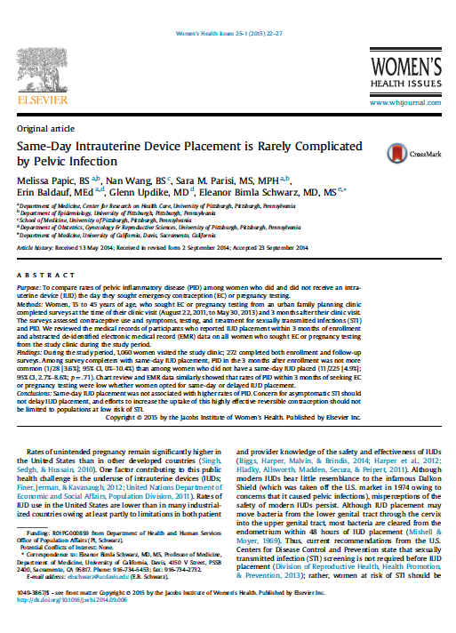
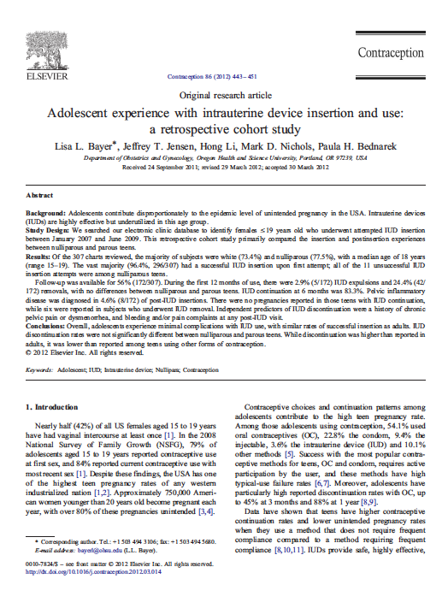
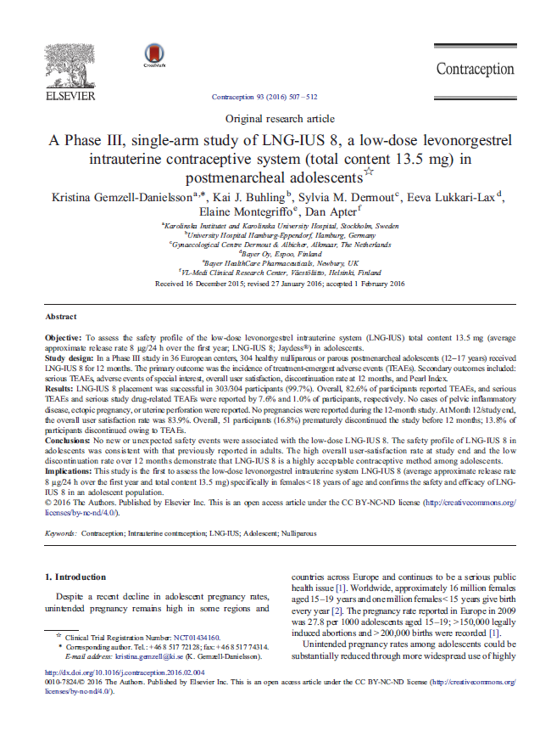
Recent small studies
Bayer LL, et al. Contraception 2012;86(5):443-451
Papic M, et al. Womens Health Issues 2015;25(1):22-7
Gemzell-Danielsson K, et al. Contraception 2016;93(6):507-12
Notes:
Speaker notes:
Three recently completed, small studies, in high-risk populations were included in the review.¹⁻³
References;
Bayer LL, et al. Adolescent experience with intrauterine device insertion and use: a retrospective cohort study. Contraception 2012;86(5):443-451.
Papic M, et al. Same day intrauterine device placement is rarely complicated by pelvic infection. Womens Health Issues 2015;25(1):22-7.
Gemzell-Danielsson K, et al. A Phase III , single-arm study of LNG-IUS 8, a low-dose levonorgestrel intrauterine contraception system (total content 13.5 mg) in postmenarcheal adolescents. Contraception 2016;93(6):507-12

Slide 28
Even smaller studies in at-risk populations show a low incidence of PID¹⁻³
Patient record review (adolescent women <19 years)
Self-reported questionnaire at 3 months (women seeking emergency contraception or walk-in pregnancy testing)
All studies evaluated PID incidence in small, at-risk populations, despite this incidence of PID was still found to be low¹⁻³
Overall incidence of PID (%)
4.6%*
(n=172)
5
3.6% (n=1754)
4
3
Incidence of PID (%)
Prospective study of safety of IUC including incidence of PID at 12 months
2
1
0.0% (n=304)
0
Bayer et al, 2012¹
Papic et al, 2015²
Gemzell-Danielsson et al, 2017
*No CI available
Study author and year
1. Bayer LL, et al. Contraception 2012;86(5):443-451.
2. Papic M, et al. Womens Health Issues 2015;25(1):22-7.
3. Gemzell-Danielsson K, et al. Contraception 2016;93(6):507-12
Notes:
Speaker notes:
Two retrospective studies carried out a retrospective evaluation of the incidence of PID in small, at-risk groups of women.^{1,2}
Bayer et al¹ looked at the incidence of PID at 12 months with IUC in adolescent women (<19 years) (n=172) from patient records.
Papic et al² looked at the incidence of PID at 3 months with IUC in women seeking emergency contraception (EC) or walk-in pregnancy testing at an urban family planning clinic (n=272) via self-reporting questionnaire.²
Gemzell-Danielsson et al³ evaluated the safety of low-dose IUC (including incidence of PID at 12 months) in nulliparous and parous adolescent women requesting contraception (aged 12–17 years) (n=304).³
No cases of PID were reported amongst the study population at 12 months.
References:
Bayer LL, et al. Adolescent experience with intrauterine device insertion and use: a retrospective cohort study. Contraception 2012;86(5):443-451.
Papic M, et al. Same day intrauterine device placement is rarely complicated by pelvic infection. Womens Health Issues 2015;25(1):22-7.
Gemzell-Danielsson K, et al. A Phase III , single-arm study of LNG-IUS 8, a low-dose levonorgestrel intrauterine contraception system (total content 13.5 mg) in postmenarcheal adolescents. Contraception 2016;93(6):507-12

Slide 29
Small studies: description and outcomes
 | Bayer LL, et al, 2012¹ | Papic M, et al, 2015² | Gemzell-Danielsson K, et al, 2016³
Study description | Retrospective cohort study of 307 women, aged ≤19 years, who had an IUC placement or attempted IUC placement | Observational study of 272 women (of which 45 received an IUC), aged between 15 and 45 years, seeking emergency contraception (EC) or walk-in pregnancy testing at an urban family planning clinic | Phase III safety study of low-dose IUC in 304 postmenarcheal adolescents (of which 303 received IUC), aged between 12 and 17 years, and requesting contraception
Objective | Primary outcome was IUC continuation rate at 6 and 12 months Secondary outcomes: pregnancy rates, side effects, infection, and difficulty or complications with IUC placement | Incidence of PID in women receiving same-day IUC placement (same day as STI screen) compared to no same-day IUC placement within 3 months/no IUC | Primary outcome was incidence of treatment-related adverse events
Definition of PID | PID defined using CDC minimal criteria for empiric treatment: Provider recommending antibiotics and describing cervical motion or uterine or adnexal tenderness without specific need for fever or leukocytosis | Diagnosis of PID in previous 3 months as noted by experience of symptoms indicating possible PID in a follow-up survey: pelvic pain pelvic tenderness or unusual vaginal discharge, with or without tenderness | Diagnosis of PID was based on investigator assessment
Notes:
Speaker notes:
The study descriptions, objectives and definition of PID used in each study are summarised if more information is required.
References:
Bayer LL, et al. Adolescent experience with intrauterine device insertion and use: a retrospective cohort study. Contraception 2012;86(5):443-451.
Papic M, et al. Same day intrauterine device placement is rarely complicated by pelvic infection. Womens Health Issues 2015;25(1):22-7.
Gemzell-Danielsson K, et al. A Phase III , single-arm study of LNG-IUS 8, a low-dose levonorgestrel intrauterine contraception system (total content 13.5 mg) in postmenarcheal adolescents. Contraception 2016;93(6):507-12

Slide 30
Study findings support same-day IUC placement in adolescent women
Overall incidence of PID at 6 months (%)
The overall incidence of PID across women for whom follow-up data was available was 4.6%
Of those with a positive Chlamydia screening, there was only one case of PID, which was treated without IUC removal
4.6%
(n=172)
5
4
3
Incidence of PID (%)
2
1
0
Women with follow-up data
Retrospective cohort study of 307 adolescent women: PID risk following IUC placement
1. Bayer LL, et al. Contraception 2012;86(5):443-451.
Notes:
Speaker notes:
The overall incidence of PID across women for whom follow-up data was available was 4.6%:¹
Complete 6-month follow-up data were only available for 43% of women;
12-month follow-up data were complete for only 11.6% of women.
98% of women were screened for Chlamydia at the time of placement.¹
Of those with a positive Chlamydia screening (13/302), there was only one case of PID, which was treated without IUC removal.
Reference:
Bayer LL, et al. Adolescent experience with intrauterine device insertion and use: a retrospective cohort study. Contraception 2012;86(5):443-451.

Slide 31
Incidence of PID is similar in women with same-day IUC placement vs. no IUC placement
No significant difference in the incidence of PID between those women receiving same-day IUC and no IUC at 3 months (via self-reported survey)
1.9% of women using hormonal contraception and 0.9% of women using no contraception were diagnosed with PID
Overall incidence of PID at 3 months (%)
14
11.8%
[95% CI, 0.0%–27.1%] (n=17)
12
10
8
Incidence of PID (%)
4.9%
[95% CI, 2.7%–8.6%] (n=277)
6
3.6%
[95% CI, 0%–10.4%] (n=28)
4
2
0
Same-day IUC
No IUC
Delayed IUC
Observational study of 272 women: impact of same-day IUC placement on PID risk
1. Papic M, et al. Womens Health Issues 2015;25(1):22-7.
Notes:
Speaker notes:
No significant difference in the incidence of PID between those women receiving same-day IUC and no IUC at 3 months (via self-reported survey):¹
3.6% in women with same-day IUC placement;
4.9% in women with no IUC placement;
11.8% in women with delayed IUC placement;
No significant difference in the incidence of PID between same-day placement and delayed placement (6.5% vs. 5.0%) (via EMR).¹
1.9% of women using hormonal contraception and 0.9% of women using no contraception were diagnosed with PID.¹
Reference:
Papic M, et al. Same day intrauterine device placement is rarely complicated by pelvic infection. Womens Health Issues 2015;25(1):22-7.

Slide 32
Summary and conclusions

Slide 33
Summary
Although the clinical diagnosis of PID may be seen as difficult and the incidence of PID among users of IUC is subject to study population, design, duration and follow-up…
Historic data and review articles show the incidence of PID to be low in women using IUC¹⁻⁶
More recent studies confirm the incidence of PID in women using IUC to be low, irrespective of age, parity, STI risk, and timing of STI screening and placement⁷⁻¹⁵
1. Farley TMM, et al. Lancet 1992;339:785-8.
2. Meirik O. Review article. Contraception 2007;75(6 Suppl):S41-S47.
3. Lyus R, et al. Contraception 2010;81(5):367-71.
4. Blumenthal PD, et al. Hum Reprod Update 2011;17(1):121-37.
5. Carr, et al. J Adolesc Health 2013;52(4):S22-S28.
6. Jatlaoui TC, et al. Contraception 2016;94:701-712.
7. Jatlaoui TC, et al. Contraception 2016;95(1):17-39.
8. Sufrin CB, et al. Obstet Gynecol 2012;120(6):1314-21.
9. Birgisson NE, et al. J Womens Health (Larchmt) 2015;24(5):354-9.
10. Gemzell-Danielsson K, et al. PLoS ONE 2015.
11. Turok D, et al. Am J Obstet Gynecol 2016;215:599.
12. Gemzell-Danielsson K, et al. Eur J Obstet Gynecol RB 2017;210:22-28.
13. Bayer LL, et al. Contraception 2012;86(5):443-451.
14. Papic M, et al. Womens Health Issues 2015;25(1):22-7.
15. Gemzell-Danielsson K, et al. Contraception 2016;93(6):507-12
Notes:
Speaker notes:
Although the clinical diagnosis of PID may be seen as difficult and the incidence of PID among users of IUC is subject to study population, design, duration and follow-up…
Historic data and review articles show the incidence of PID to be low in women using IUC.¹⁻⁶
More recent studies confirm the incidence of PID in women using IUC to be low, irrespective of age, parity, STI risk, and timing of STI screening and placement.⁸⁻¹⁵
References;
Farley TMM, Rosenberg MJ, Rowe PJ, et al. Intrauterine devices and pelvic inflammatory disease: an international perspective. Lancet 1992;339:785-8.
Meirik O. Intrauterine devices – upper and lower genital tract infections. Review article. Contraception 2007;75(6 Suppl):S41-S47.
Lyus R, et al. Use of the Mirena LNG-IUS and Paragard CuT380A intrauterine devices in nulliparous women. Contraception 2010;81(5):367-71.
Blumenthal PD, et al. Strategies to prevent unintended pregnancy: increasing use of long-acting reversible contraception. Hum Reprod Update 2011;17(1):121-37.
Carr S, et al. Intrauterine Devices and Pelvic Inflammatory Disease Among Adolescents. J Adolesc Health 2013;52(4):S22-S28.
Jatlaoui TC, et al. The safety of intrauterine contraception initiation among women with current asymptomatic cervical infections or at increased risk of sexually transmitted infections. Contraception 2016;94:701-712.
Jatlaoui TC, et al. The safety of intrauterine devices amongst women: a systematic review. Contraception 2016;95(1):17-39.
Sufrin CB, et al. Neisseria gonorrhea and Chlamydia trachomatis screening at intrauterine device insertion and pelvic inflammatory disease. Obstet Gynecol 2012;120(6):1314-21.
Birgisson NE, et al. Positive Testing for Neisseria gonorrhoeae and Chlamydia trachomatis and the Risk of Pelvic Inflammatory Disease in IUD Users. J Womens Health (Larchmt) 2015;24(5):354-9.
Gemzell-Danielsson K, et al. The effect of age, parity and body mass index on the efficacy, safety, placement and user satisfaction associated with two low-dose levonorgestrel intrauterine contraceptive systems; subgroup analysis of data from a phase III trial. PLoS ONE 2015.
Turok D, et al. A prospective assessment of pelvic infection risk following same-day sexually transmitted infection testing and levonorgestrl intrauterine system placement. Am J Obstet Gynecol 2016;215:599
Gemzell-Danielsson K, et al. Evaluation of a new, low-dose levonorgestrel intrauterine contraceptive system over 5 years of use. Eur J Obstet Gynecol RB 2017;210:22-28.
Bayer LL, et al. Adolescent experience with intrauterine device insertion and use: a retrospective cohort study. Contraception 2012;86(5):443-451.
Papic M, et al. Same day intrauterine device placement is rarely complicated by pelvic infection. Womens Health Issues 2015;25(1):22-7.
Gemzell-Danielsson K, et al. A Phase III , single-arm study of LNG-IUS 8, a low-dose levonorgestrel intrauterine contraception system (total content 13.5 mg) in postmenarcheal adolescents. Contraception 2016;93(6):507-12.

Slide 34
Summary (cont.)
A recent systematic review assessing the safety of IUC use in young women (<25 years) concluded PID to be rare and there to be no difference in risk of PID in IUC (LNG-IUS) users when compared to women using COCs and implants (ENG)¹
PID can be treated successfully in the small number of women affected without the need for device removal²
But, when counselling women about contraception, we need to remind them that additional protection, i.e. condoms, against STIs is needed with new partners
Jatlaoui TC, et al. Contraception 2016;94:701-712.
Turok D, et al. Am J Obstet Gynecol 2016;215:599
Notes:
Speaker notes:
A recent systematic review assessing the safety of IUC use in young women (<25 years) concluded PID to be rare and there to be no difference in risk of PID in IUC (LNG-IUS) users when compared to women using COCs and implants (ENG)⁶
PID can be treated successfully in the small number of women affected without the need for device removal¹¹
But, when counselling women about IUC, it is important to remember to remind them that additional protection, i.e. condoms, against STIs is needed with new partners.
References;
Jatlaoui TC, et al. The safety of intrauterine contraception initiation among women with current asymptomatic cervical infections or at increased risk of sexually transmitted infections. Contraception 2016;94:701-712.
Turok D, et al. A prospective assessment of pelvic infection risk following same-day sexually transmitted infection testing and levonorgestrl intrauterine system placement. Am J Obstet Gynecol 2016;215:599

Slide 35
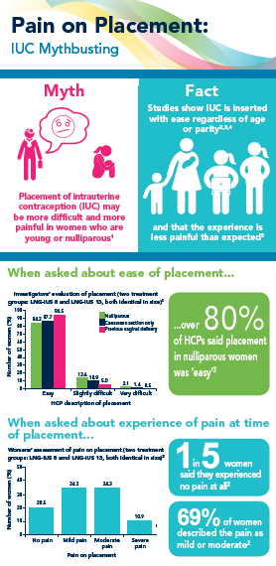
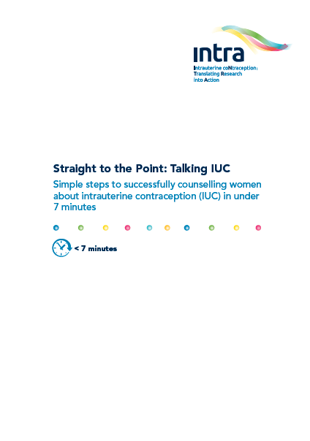
Where do we go from here?
Hopefully the findings of this review address your concerns, and those of your colleagues, about using IUC in all women
If you do have further questions, the INTRA group has a number of resources that may help:
Other materials in the ‘Straight to the Point: Talking IUC’ series:
Straight to the Point: Talking IUC
Simple steps to successfully counselling women about intrauterine contraception in under 7 minutes
Straight to the Point: Talking IUC
Step-by-step guidance to addressing concerns with intrauterine contraception
Myth-busting infographics series
Hints and Tips slide set
The INTRA materials can be found on www.your-life.com/HCP

